Slide 1


Scalability in Practice: a Highly scalable web app
CSP 2025
Xingda Wei / Yubin Xia
IPADS, Shanghai Jiao Tong University
https://www.sjtu.edu.cn

Slide 2




Scalable web apps are everywhere: pre-AI era
High request rate
100 billions of requests daily
Massive data
Facebook has more than 1 billion of images uploaded weekly, Baidu stores tens of billions of web pages
Transparent scale
The system performs seamlessly no matter how the workloads scale

Slide 3

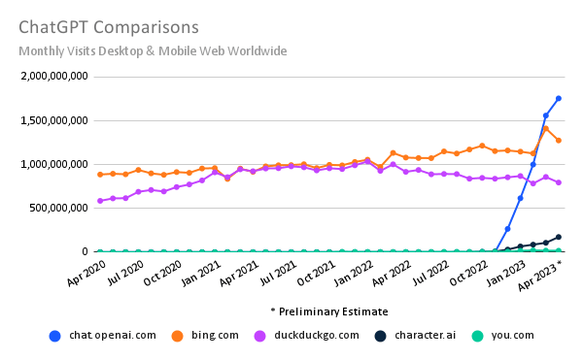
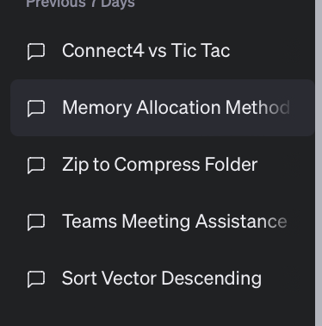
Scalable web apps are everywhere: AI era
Essentially, also a web APP
Pre-AI era: request handling = order an item
AI era: request handling = use model to do one or multiple inferences
The same system requirements
High request rate
Massive data: both for training & for serving history data
Transparent scaling
New requirements
Huge computation power required
According to GPT (☺), an inference of GPT ~= sorting 100,000,000 numbers
Per-user sessions

Slide 4


Transparent scale is challenging
What does server is busy means?
Especially when the usage increases
To answer these questions, we need to see how modern services are built!

Slide 5
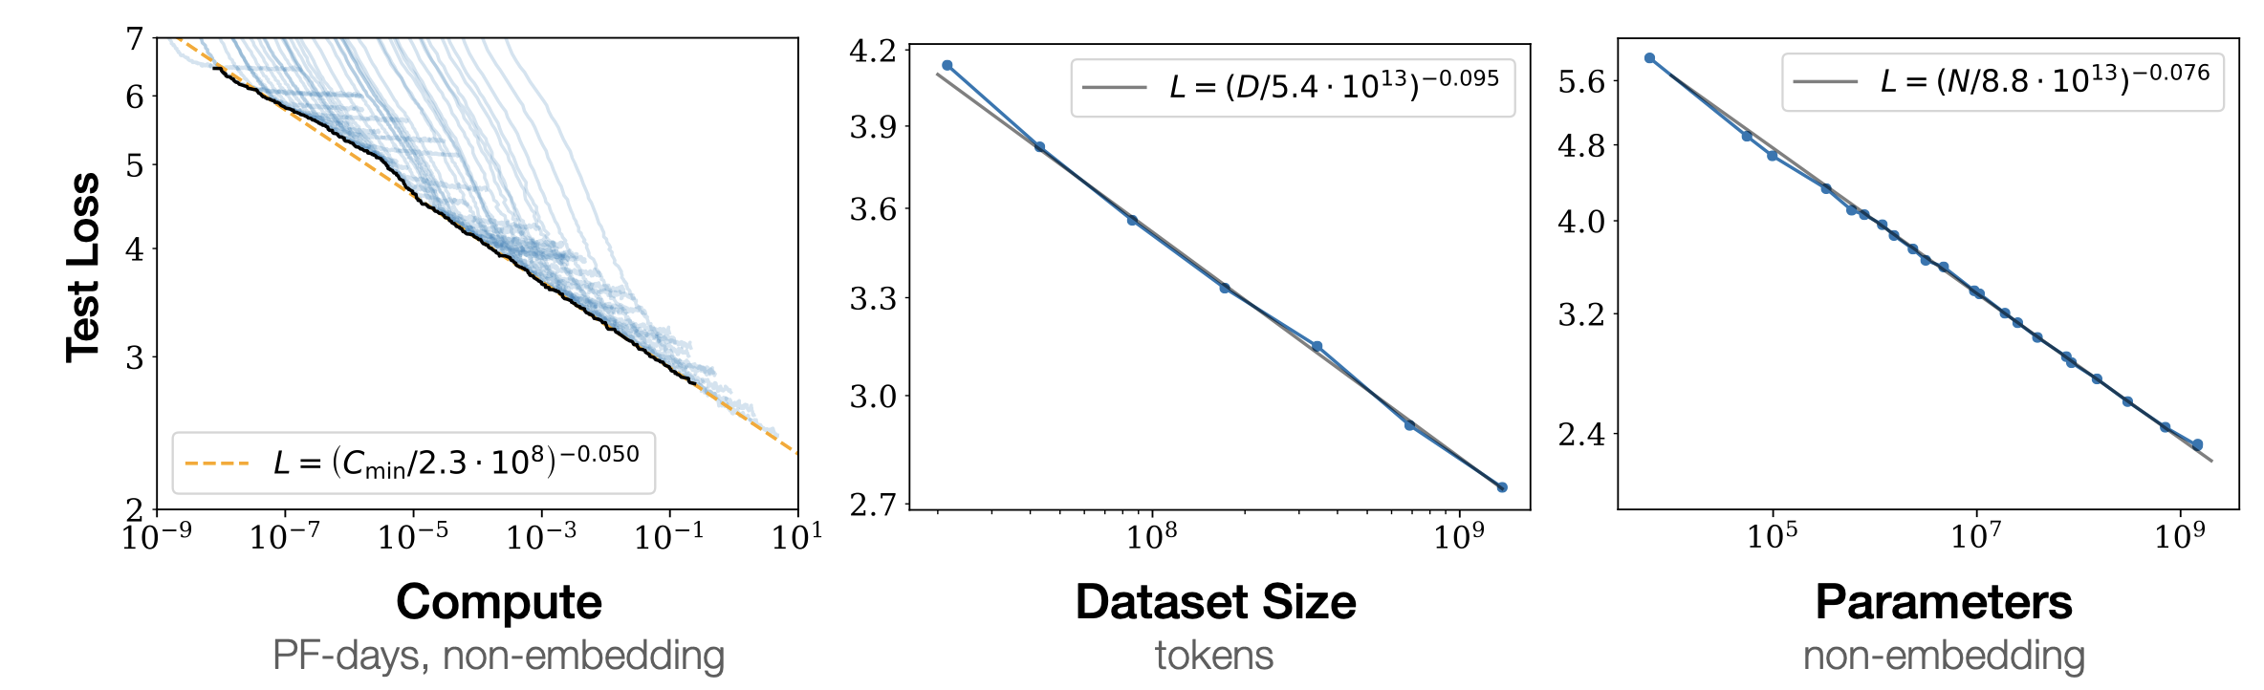
Scalability is everywhere in computing systems
Example: scaling law
Massive data needed (the larger, the better)
Massive model needed (the larger, the better)
Massive computation power needed

Slide 6
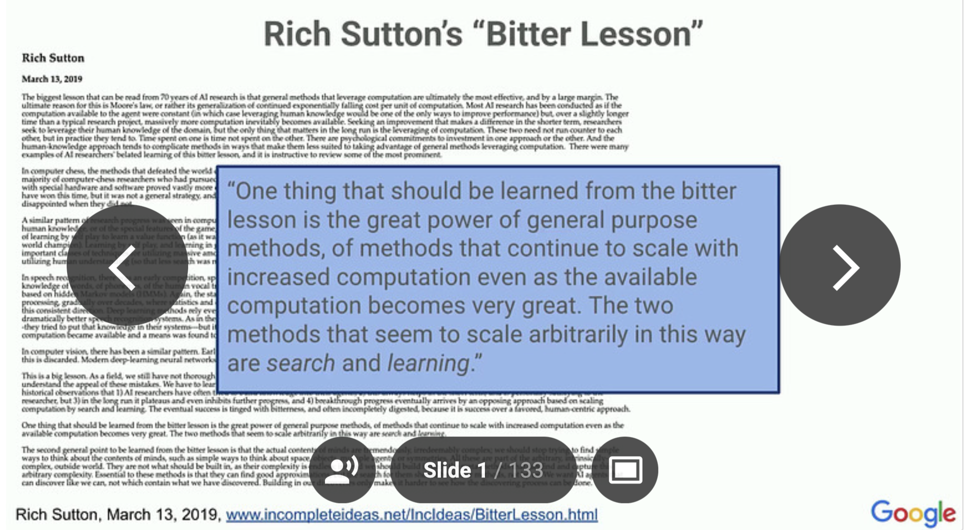
Example: Bitter Lesson

Slide 7
Yet, the key principles & techniques in building scalable system is similar: i.e., we need to build a distributed (and parallel) system
Notes:
2003 年马云 创建淘宝

Slide 8

Case study: An e-commerce web application
Notes:
2003 年马云 创建淘宝

Slide 9

Each click needs thousands of servers to cooperate
Caching server
Caching server
…
Caching server
Caching
Caching
Caching
Distributed caching
Database server
Database server
CDN
Users
Application #1
generate the page
Database
user, price
…
Database
user, price
Application server
Distributed database
Internet
Load
Balance
Application #2
add the order
File server
File server
File server
File:
image
File:
image
…
File:
image
Application server
…
…
Message queue
Distributed file system

Slide 10
How to build Taobao on a single machine (in old days)?
Operating system:
Linux (in OS class)
Serving the requests: web server
Apache, Nginx (in ICS)
Serving the data: file system & DB
MySQL & inode file system (in CSE)
Displaying the page: HTML
PHP (in Web class)
LAMP = Linux + Apache + MySQL + PHP

Slide 11

Using one server to build Taobao
https://www.taobao.com
Internet
Application
generate the web page
File:
image
Database:
user, price
Server

Slide 12
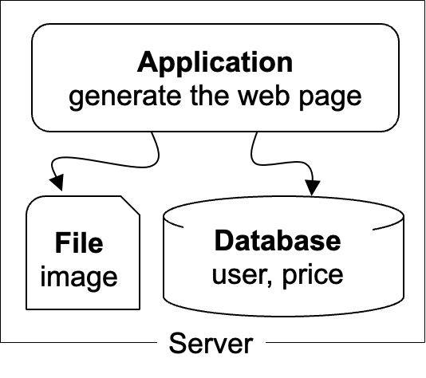
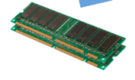
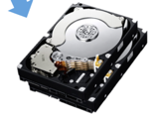
The architecture of LAMP scales poorly!
https://www.taobao.com
Internet
The disk & memory of one server cannot store massive amount of data
DRAM: 64 – 256 GB
HDD: 2 – 40 TB
Facebook has more than 1 billion of images uploaded weekly, Baidu stores tens of billions of web pages
File:
image
Database:
user, price
DRAM
HDD

Slide 13

Step #1 for scalability: disaggregating application & data
Database: requires reading/writing disk & cache
Can be scaled with faster disks & larger memory
File system: store large bulks of data
E.g., images, videos
Can be scaled with faster disks
Vendors like Oracle provides databases/filesystems support with huge volumn
Application
generate the web page
Application server
Local area network
File server
Database server
Scale
Scale
File:
image
Database
user, price
Database
user, price

Slide 14
Step #2 Avoid the slow data accesses? Caching
Observation: most requests access a small portion of the data (locality)
Caching system with a single node:
E.g., page cache
Drawbacks: limited DRAM capacity
Distributed caching server
Benefits: huge DRAM capacity, e.g., deploy many caching servers
Application
generate the web page
Application server
Local area network
Caching server
Caching server
Caching
Caching
File server
Database server
File:
image
Database
user, price

Slide 15
Case study of distributed cache server: Memcached
Distributed caching server
Benefits: huge DRAM capacity
Memcached server
Store all the cached data in memory
Can scale out to use multiple servers
Memcached clients
Check whether server has cached data
On cache miss, fallback to database/file
Question:
How to find which server has cached the data?
Application
generate the web page
Net
Comm
Memached API
S0: 10.0.0.100
S1: 10.0.0.101
Routing
Application server
Local area network
Caching server#0:
10.0.0.100
Caching server#1:
10.0.0.101
Caching
Memached
Caching
Memached

Slide 16
Case study of distributed cache server: Memcached
Naïve method, hashing:
address = Hash(key) % #server
Problem:
What if we add a new server?
Suppose that we add server from 3→4
Then there would be ~50% miss!
Solution: consistent hashing
Suppose that we add server from 3→4
It will only incur < 25% miss
More details in later lectures
How to find the data?
Consistent hashing

Slide 17
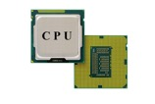
The architecture of LAMP scales poorly!
https://www.taobao.com
Internet
Application uses the CPU for processing, while a single CPU can hardly scale due to the end of Moore’s law & Dennard scaling
Moore’s law: the number of transistors in a dense integrated circuit (IC) doubles about every two years.
Dennard scaling: as transistors get smaller, their power density stays constant
Application
generate the web page
Notes:
摩尔定律：元器件上的元器件翻倍
Dennard： 尺寸缩小，能耗降低

Slide 18
Step #3 for scalability: more app servers
Internet
We can add more servers for scaling its performance
Simple for stateless jobs (e.g., web service)
What is stateless?
The server only executes the logic that only relies on input data but no long-term state
We can do so for stateful jobs but requires more work ☺
Application
generate the web page
Application
generate the web page
Application
generate the web page
Application server #N
Application server #N
Application server #N
Local area network
Caching server
Caching server
Caching
Caching
File server
Database server
File:
image
Database
user, price

Slide 19
Step #3 for scalability: How to do the load balance?
Load balance: how to route the user quests to the application servers?
Leverage the network layer
HTTP redirection,
reverse proxy,
…
Load balance algorithms
round-robin,
random,
hashing,
…
Internet
Load balancer
Application
generate the web page
Application
generate the web page
Application
generate the web page
Application server #N
Application server #N
Application server #N

Slide 20
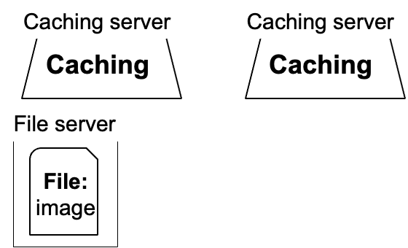
Step #4 for scalability: distributed databases
#1. Separate the database for read/write
E.g., use primary-backup replication
The primary servers the writes and backup only serves reads
#2. Separate a table on multiple databases
e.g., a bank has reported that a single table has 100,000,000 rows
However, split a table on multiple machines complex consistency management
Application
generate the web page
Application
generate the web page
Application
generate the web page
Application server #N
Application server #N
Application server #N
Local area network
Write
Read
Database server
Database server
Database
user, price
Database
user, price

Slide 21
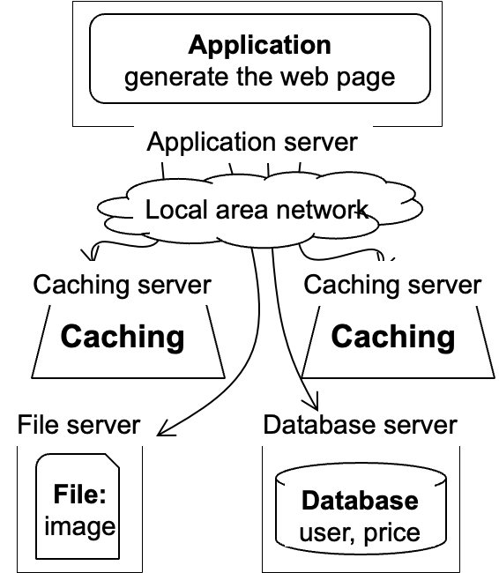
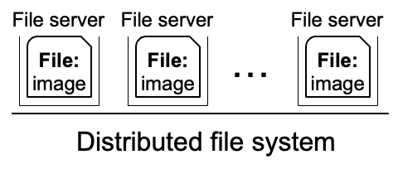
Step #5 for scalability: distributed file system
Using multiple database in principle makes the database distributed
We can use a similar approach to make the file system distributed !
Well-known distributed file system
NFS (Network file system)
GFS (Google file system)
HDFS
Ceph
Etc.
Application
generate the web page
Application server
Local area network

Slide 22
Summary: scalable website so far
The compute/storage is processed on multiple servers' w/ disaggregation
Independently scaled according to requirements
Each time it scales, a new problem may arise
Caching server
Caching server
…
Caching server
Caching
Caching
Caching
Distributed caching
Database server
Database server
Users
Application #1
generate the page
Database
user, price
…
Database
user, price
Application server
Distributed database
Internet
Load
Balance
Application #2
add the order
File server
File server
File server
File:
image
File:
image
…
File:
image
Application server
…
…
Message queue
Distributed file system

Slide 23

Step #6 for scalability: using CDN
Goal: return the results to user as soon as possible
Why? Amazon has reported that 100ms latency increase will cause 1% financial loss
Core idea: caching (again)
E.g., CDN (content delivery network) caches the content at the network providers, which is closer to users
Challenge: how to do it without users’ awareness?
CDN
Users
Application
generate the web page
Internet
Application server
…
Notes:
Example: jquery

Slide 24


Step #7 for scalability: separate different applications
Use dedicated servers for different applications
Question: How to run different servers on top of the same hardware?
Containers w/ K8S (In other courses)
Application #1
Alipay
Internet
Application server
Application #2
Taobao
Application server

Slide 25


How to handle complex requests?
Example: after the website becoming larger, handling requests is far more than displaying a (static) web page
Alipay (支付宝)
E.g., fraud detection
Taobao
Hot list (热榜)
Dynamic product ads (千人千面)
Recommendation (you might also like)
…
Hot lists
Customized ads

Slide 26
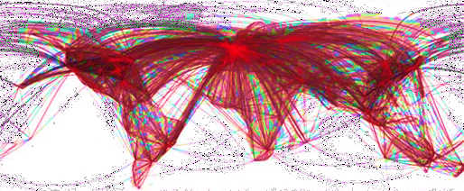

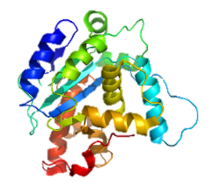

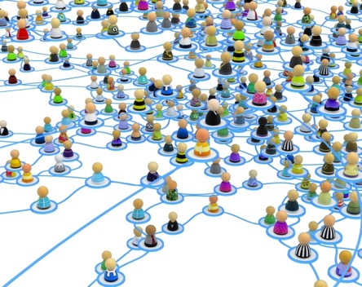


Use distributed computing frameworks for complex queries
General batch processing systems
MapReduce, Spark, etc.
Graph processing systems
GraphLab, Pregel, etc.
AI systems
Pytorch, vLLM, Megatron, etc.

Slide 27
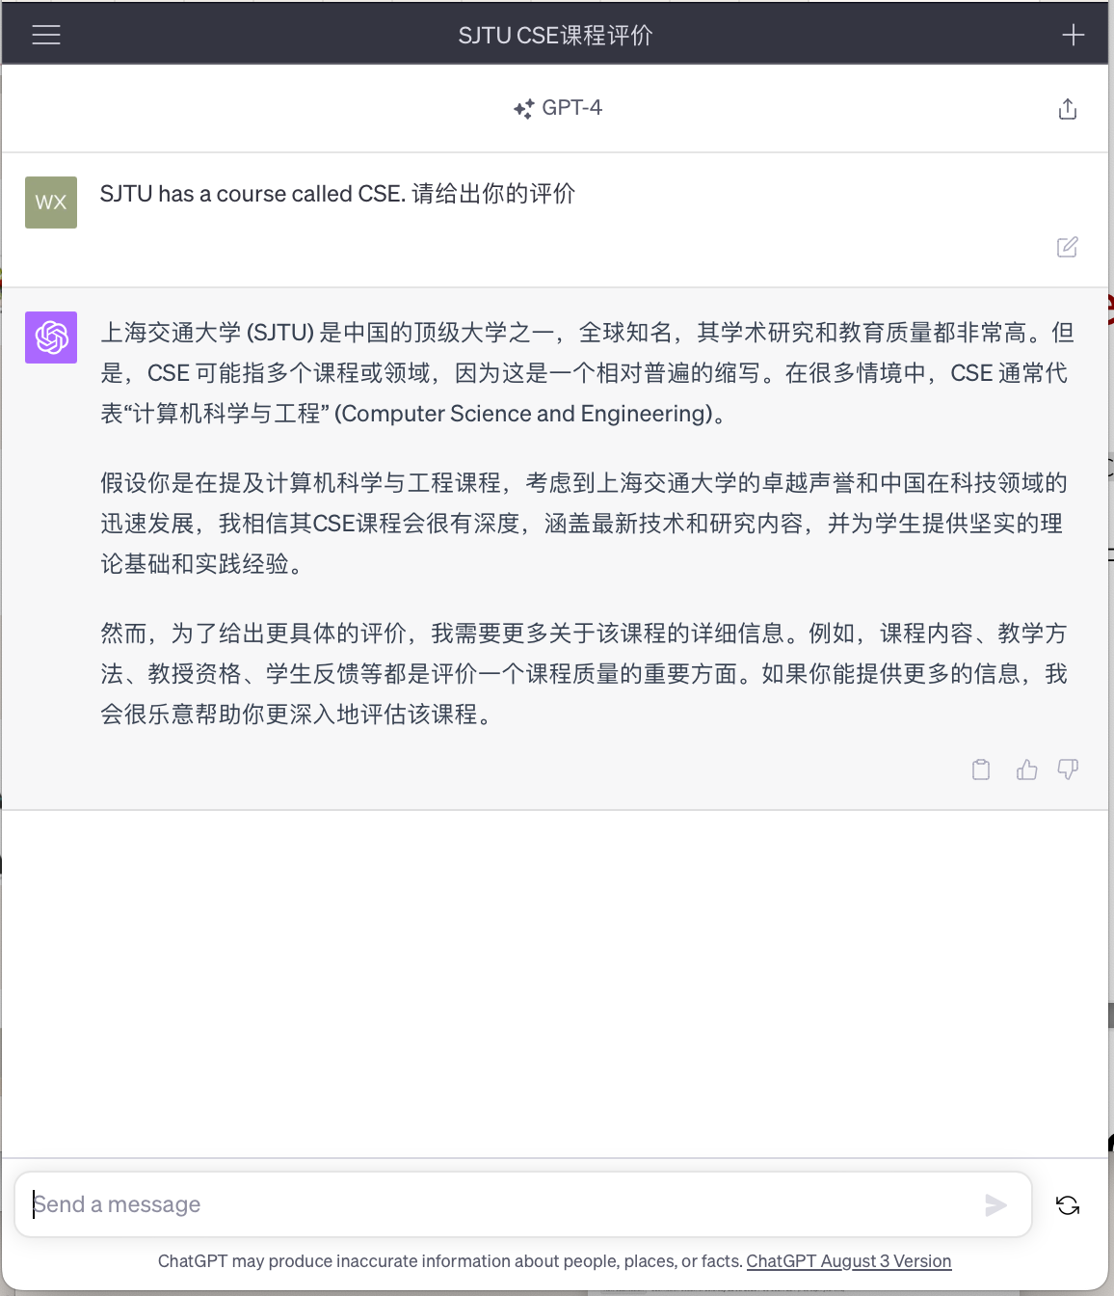
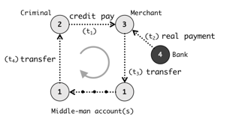

Step #7: separated applications + distributed computing
Example (Each system is backed by multiple machines)
Use general batch processing system to generate hot list
Use graph system to detect credit card fraud
ML framework
e.g., Pytorch, Deepspeed
Application #3
Chatbot
Application server
Application #1
Alipay
Graph processing
e.g., GraphLab
Internet
Application server
Generate hot lists
Application #2
Taobao
Batch processing
e.g., MapReduce
Application server

Slide 28
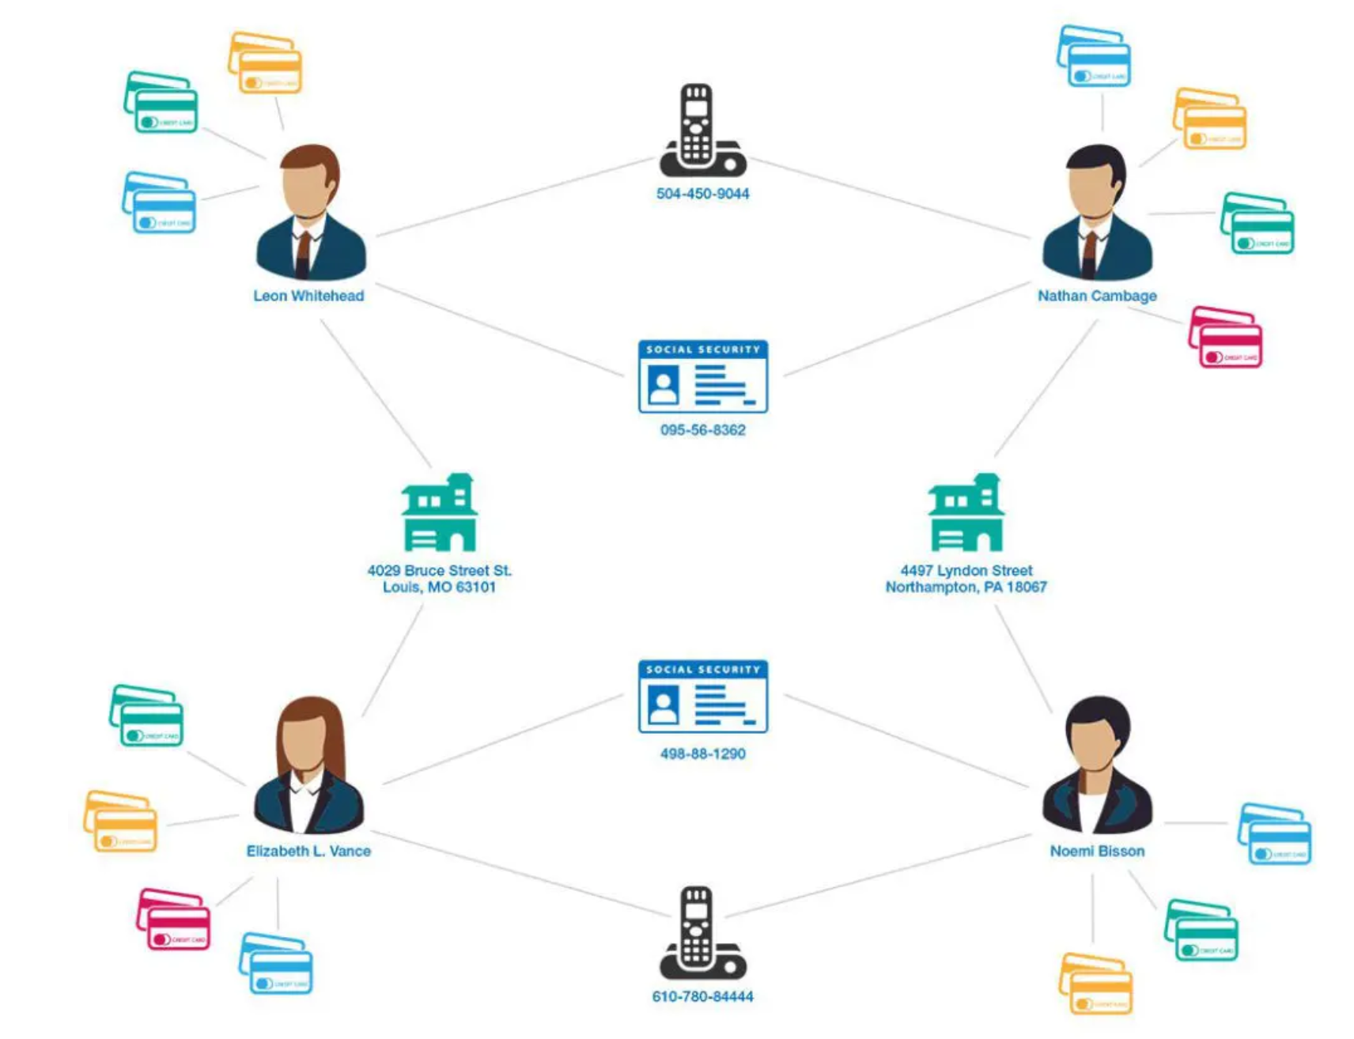
Computation frameworks to support different services
Hot topics
Fraud detection
Chat Bot
Scalable graph processing system
Source: https://www.graphable.ai/blog/graph-database-fraud-detection/
Scalable batch processing system
Scalable ML/AI systems

Slide 29
A scalable website: powered by distributed (parallel) systems!
Distributed system: A distributed system is a collection of independent computers that appears to its users as a single coherent system.
- DISTRIBUTED SYSTEMS Principles & Paradigms, Second Edition
Caching server
Caching server
Caching server
…
Caching
Caching
Caching
Distributed caching
Database server
Database server
CDN
Users
Application #1
generate the page
Database
user, price
…
Database
user, price
Application server
Distributed database
Internet
Load
Balance
Application #2
add the order
File server
File server
File server
File:
image
File:
image
…
File:
image
Application server
…
…
Message queue
Distributed file system

Slide 30
Modern scalable system systems are
large & distributed
Powered by large-scale datacenter

Slide 31
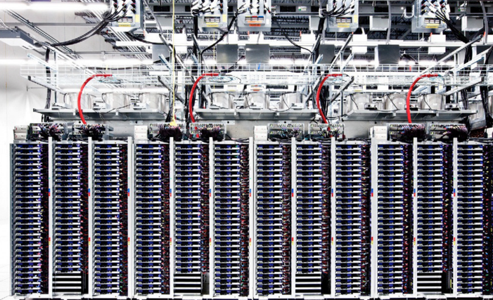
Scalable websites are powered by modern datacenters
Large server and storage farms
CPUs/GPUs/XPUs: > 20,000,000 cores
Disk capacity: > 1,000,000 GB
10-100 MW of power -> 1.1GW (AI cluster)
Caching server
Caching server
…
Caching server
Caching
Caching
Caching
Distributed caching
Database server
Database server
CDN
Users
Application #1
generate the page
Database
user, price
…
Database
user, price
Application server
Distributed database
Internet
Load
Balance
Application #2
add the order
File server
File server
File server
File:
image
File:
image
…
File:
image
Application server
…
…
Distributed file system

Slide 32

Datacenters that power the scalable website
Large-scale distributed systems: 10K – 100K servers
Each rack: 40 servers (Fewer if w/ GPU)
Complex networking for connecting servers
To cooperate, we must communicate
Source: “The Datacenter as a Computer --- An Introduction to the Design of Warehouse-Scale Machines”

Slide 33
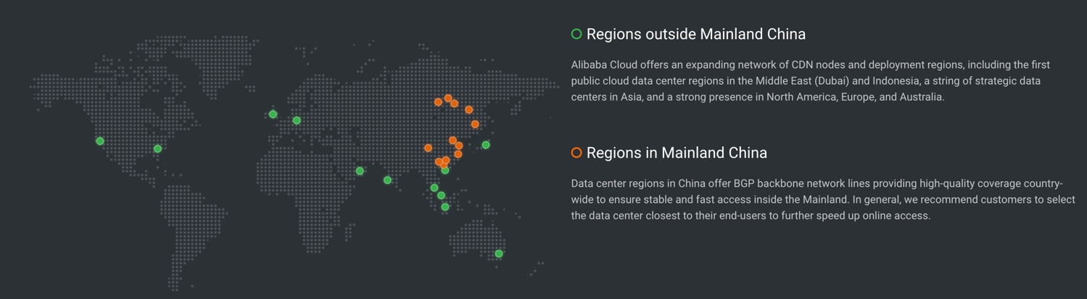
Datacenters are geo-replicated
The locations of Alibaba datacenters
Source: https://www.alibabacloud.com/zh/global-locations

Slide 34
Design large-scale distributed system is challenging
Fault is common, how to handle it?

Slide 35
Fault is common: fault, error, failure
Fault can be latent or active
if active, get wrong data or control signals
Error is the results of active fault
e.g. violation of assertion or invariant of spec
discovery of errors is ad hoc (formal specification?)
Failure happens if an error is not detected and masked
not producing the intended result at an interface
Notes:
SDC：乘法加速器比较容易出bug

Slide 36
Fault is common
, especially in large distributed systems
Why faults are common especially in distributed systems? Scale!
“Suppose a cluster has ultra-reliable server nodes with a stellar mean time between failures (MTBF) of 30 years (10,000 days)—a cluster of 10,000 servers will see an average of one server failure per day. ”
Source: The Datacenter as a Computer
-- An Introduction to the Design of Warehouse-Scale Machines

Slide 37


Fault is common
especially in large distributed systems
What are the causes?
Why faults are common especially in distributed systems? Scale!
“Suppose a cluster has ultra-reliable server nodes with a stellar mean time between failures (MTBF) of 30 years (10,000 days)—a cluster of 10,000 servers will see an average of one server failure per day. ”
Causes:
Operation error (human, configuration, etc.)
Software error (e.g., bug)
Hardware error
Power outage
Natural disaster
Source: The Datacenter as a Computer
-- An Introduction to the Design of Warehouse-Scale Machines

Slide 38
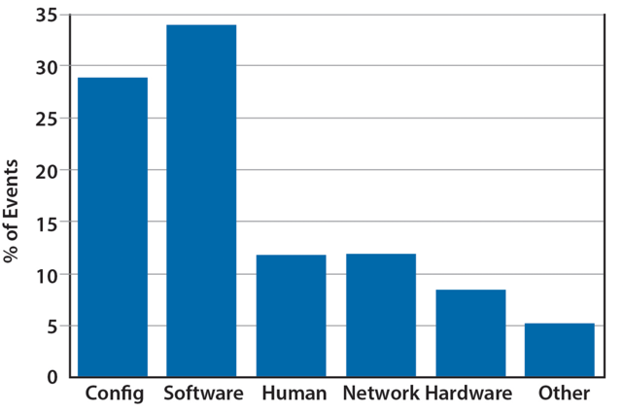
Fault is common
especially in large distributed systems
What are the causes?
Why faults are common especially in distributed systems? Scale!
“Suppose a cluster has ultra-reliable server nodes with a stellar mean time between failures (MTBF) of 30 years (10,000 days)—a cluster of 10,000 servers will see an average of one server failure per day. ”
Causes:
Operation error (human, configuration, etc.)
Software error (e.g., bug)
Hardware error
Power outage
Natural disaster
Source: The Datacenter as a Computer
-- An Introduction to the Design of Warehouse-Scale Machines

Slide 39
Faults and partial failures
On a single computer, it either works or it doesn’t
But in a distributed system, some parts of the system can be broken in some unpredictable way
Such failure is partial (aka., grey failure)
Since most parts of the system are OK, we want the system still working!

Slide 40

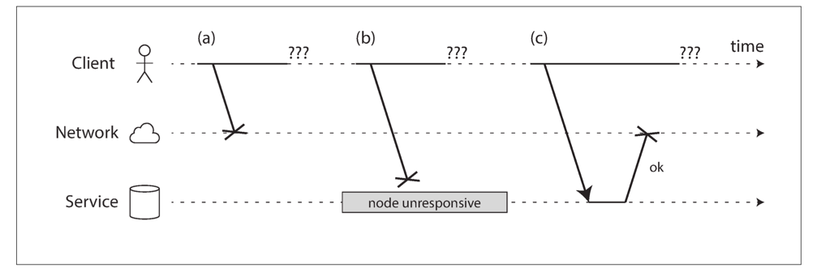
Partial failures are hard to identify
Example: unreliable network
A client (e.g., Smartphone), sends requests to the service (e.g., Taobao), through network (5G, Wifi)
The client gets: “网络竟然奔溃了”, how can a network break?
Notes:
Challenge: how to detect the faults?

Slide 41
Example: unreliable network
A user sends a request but the server does not reply, possible reasons:
1. The remote node may have failed (e.g., it crashed or it was powered down).
2. The request may have been lost (e.g., someone unplugged a network cable).
3. The request may be waiting in a queue and will be delivered later (e.g., the network or the recipient is overloaded).

Slide 42

Example: unreliable network
A user sends a request but the server does not reply, possible reasons:
4. The remote node may have temporarily stopped responding (e.g., it is experiencing a long garbage collection pause)
5. The remote node may have processed your request, but the response has been lost on the network (e.g., a network switch has been misconfigured).
6. The remote node may have processed your request, but the response has been delayed and will be delivered later (e.g., the network or your own machine is overloaded).

Slide 43
Another common fault: network partition
A network partition refers to network decomposition into relatively independent subnets
Can happen when a switch is being upgraded in a datacenter
Can even happen when being attacked by sharks
Network partition is usually a reality
You can never count on the network connectivity

Slide 44
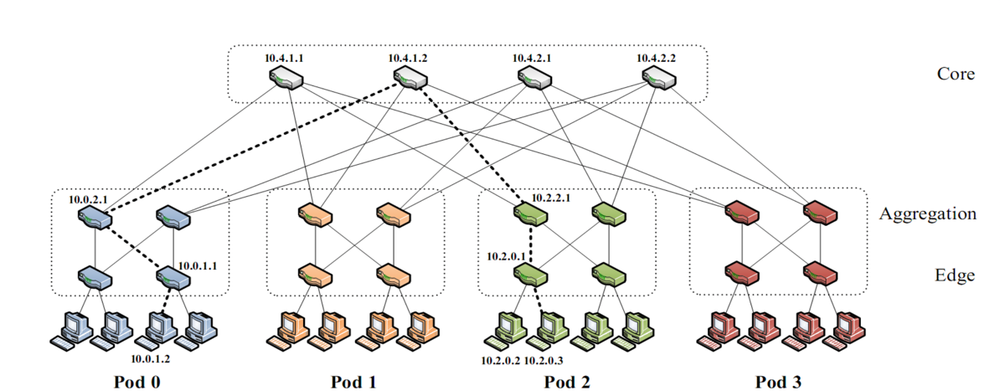
Another common fault: network partition
A network partition refers to network decomposition into relatively independent subnets
Can happen when a switch is being upgraded in a datacenter
For example, suppose the datacenter adopts a fat-tree topology
Source: https://www.cs.cornell.edu/courses/cs5413/2017sp/lectures/16-datacenter-topologies2.pdf

Slide 45
Another common fault: network partition
A network partition refers to network decomposition into relatively independent subnets
Can happen when a switch is being upgraded in a datacenter
For example, suppose the datacenter adopts a fat-tree topology
Source: https://www.cs.cornell.edu/courses/cs5413/2017sp/lectures/16-datacenter-topologies2.pdf

Slide 46
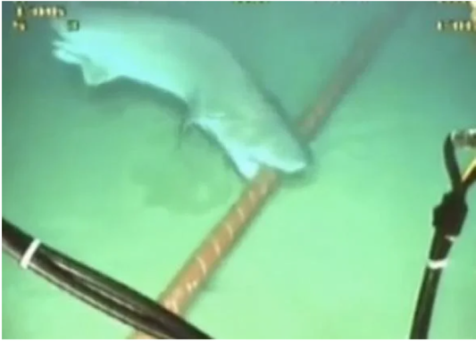
Another common fault: network partition
A network partition refers to network decomposition into relatively independent subnets
Can happen when a switch is being upgraded in a datacenter
Can even happen when being attacked by sharks
Source: https://slate.com/technology/2014/08/shark-attacks-threaten-google-s-undersea-internet-cables-video.html

Slide 47
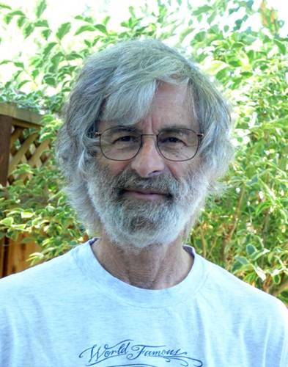
You know you have a distributed system when the crash of a computer you’ve never heard of stops you from getting any work done.
- Leslie Lamport
Lamport received the 2013 Turing Award for "fundamental contributions to the theory and practice of distributed and concurrent systems, notably the invention of concepts such as causality and logical clocks, safety and liveness, replicated state machines, and sequential consistency" in 2014.

Slide 48
Distributed system needs to handle these faults to provide an “always-on” illusion
It is not an easy task

Slide 49

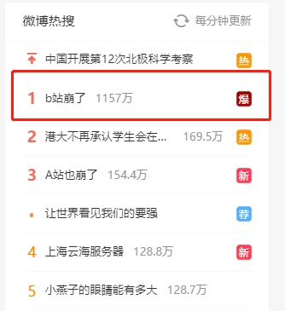




Slide 50
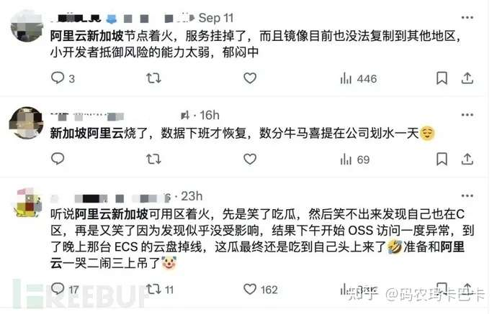
Notes:
今年9月10日，阿里云服务又宕机了。

Slide 52
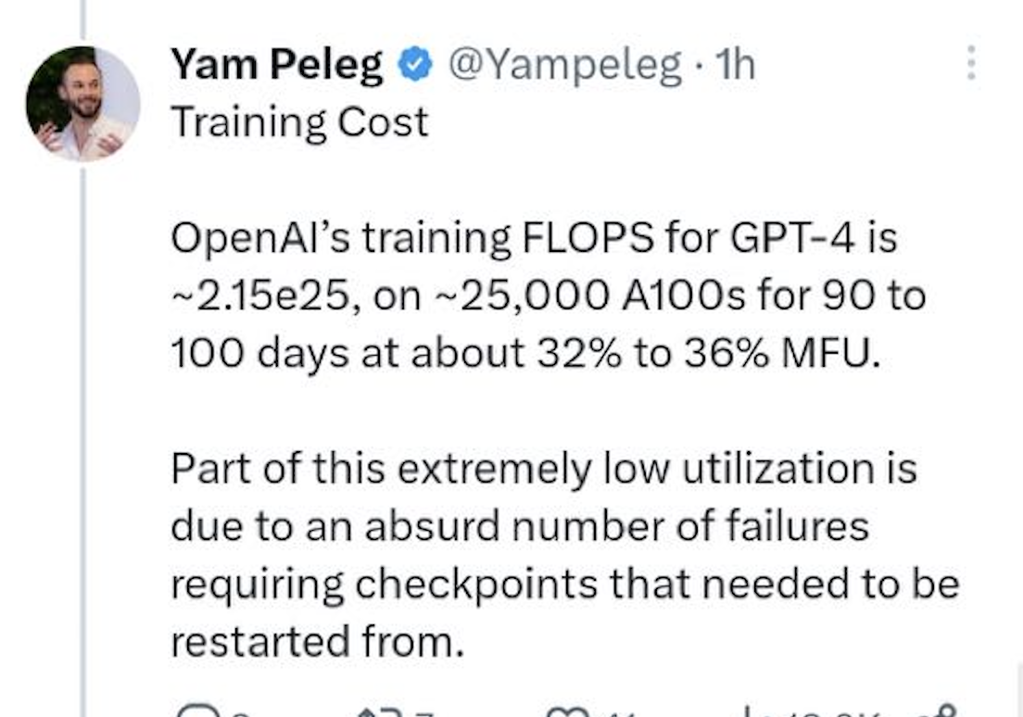
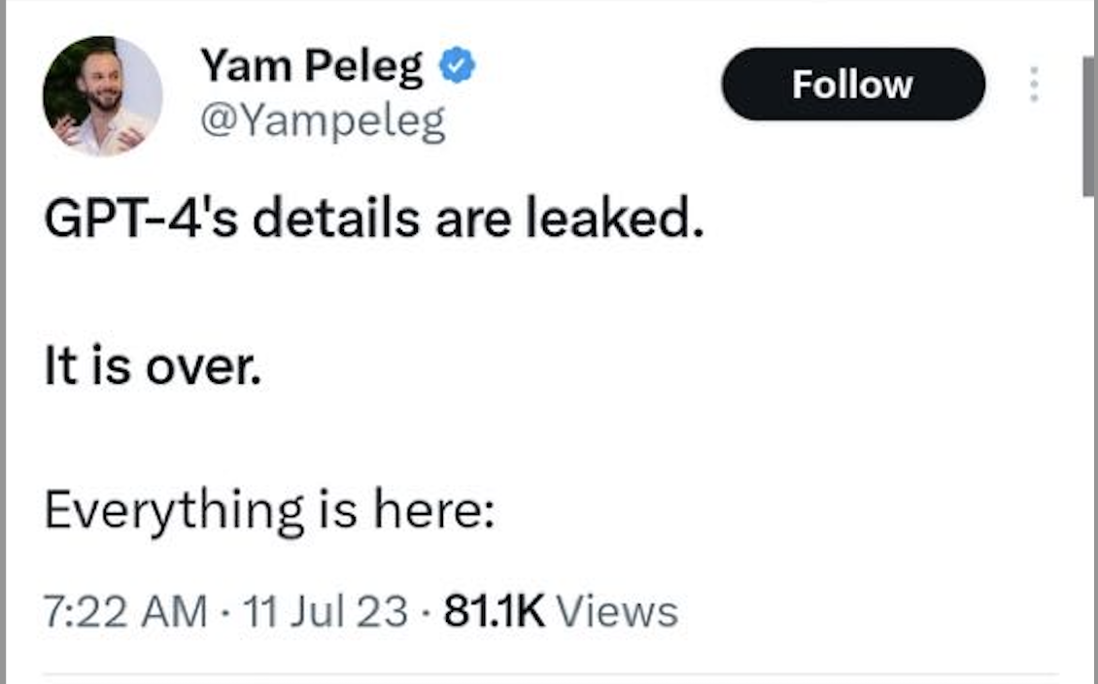

Slide 53





Yet, large-scale systems can be highly available
Case#1: Internet, the BGP (Border Gateway Protocol) is highly available
Case#2: WeChat, Taobao & Baidu rarely (but not never) become outage
Case #3: OpenAI successfully trained GPT despite many failures ☺

Slide 54
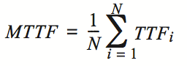
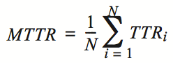
Availability and reliability
Availability: A measure of the time that a system was usable, as a fraction of the time that it was intended to be usable (x nines), corresponding downtime:
e.g. 3-nines -> 8 hour/year
e.g. 5-nines -> 5 min/year
e.g. 7-nines -> 3 sec/year
Metrics to measure reliability
MTTF: mean time to failure
MTTR: mean time to repair
MTBF: mean time between failure
MTBF = MTTF + MTTR

Slide 55
Achieving high availability: handling failures w/ replications
Replication
replicas: identical multiple copies
Example: replicated file servers
If one copy survives, the application is available
Application
generate the web page
Application server
Local area network
File server
File server
File server
File:
image
File:
image
File:
image
Identical copies

Slide 56
Challenge: consistency
Replication
replicas: identical multiple copies
Example: replicated file servers
If one copy survives, the application is available
Challenge: consistency
Application
generate the web page
Application server
Local area network
File server
File server
File server
File:
image
File:
image
File:
image

Slide 57
Challenge: consistency
Replication
replicas: identical multiple copies
Example: replicated file servers
If one copy survives, the application is available
Challenge: consistency
Application put file A to one server
Application
generate the web page
Application server
1
Local area network
File server
File server
File server
File:
image
File:
image
File:
image

Slide 58
Challenge: consistency
Replication
replicas: identical multiple copies
Example: replicated file servers
If one copy survives, the application is available
Challenge: consistency
Application put file A to one server
The server crashed
Application
generate the web page
Application server
Local area network
2
File server
File server
File server
File:
image
File:
image
File:
image

Slide 59
Challenge: consistency
Replication
replicas: identical multiple copies
Example: replicated file servers
If one copy survives, the application is available
Application put file A to one server
The server crashed
What happens when read A again?
Application
generate the web page
Application server
Local area network
3
File server
File server
File server
File:
image
File:
image
File:
image

Slide 60

Achieving high availability: handling failures
Replication
replicas: identical multiple copies
Techniques to cope ensure consistency under replication:
Primary-backup replication
Replicated state machine
…

Slide 61
Achieving high availability: handling failures via retry
Restart or reconstruct
Monitoring and catching errors
Restart or reconstruct the system (sub-system)
E.g., restart the stateless application server is ok
What about consistency? Must made trade-off
Stateless applications does not have consistency issue
Some applications, like Google search, can even tolerate occasional inconsistency
Can you notice the inconsistency of search results?
Question: can ChatBot tolerate failures via retry?

Slide 62
The CAP theorem
Consistency, Availability & Partition tolerance

Slide 63
CAP: an example
Amazon has two zones: US and Euro
All US users connect to the US zone
All Euro users connect to the Euro zone
Define Availability and Consistency
C: all users see the actual number of items
Not-C: users see 1 item left, but actually is 0
A: all users can buy items at any time (if there are some)
Not-A: users might get "cannot buy now, please wait and retry”
P: the system can get A & C even the only link between US and Euro is broken
Not-P: otherwise

Slide 64
The CAP theorem: 2 out of 3
It is impossible for a distributed computer system to simultaneously provide all three of the following guarantees
Consistency (all nodes see the same data at the same time)
Availability (a guarantee that every request receives a response about whether it succeeded or failed)
Partition tolerance (the system continues to operate despite arbitrary message loss or failure of part of the system)
v₀
v₀
v₀
v₀
v₁
v₀
v₁
v₀
v₁
v₀
S₁
S₂
S₁
S₂
S₁
S₂
S₁
S₂
S₁
S₂
S₁
S₂
A=v₁
done
A=?
1. A=v₀
C
C
C
C
C
C
2. Not available

Slide 65


Partition Tolerance
"P" is usually a reality
You can never count on the network connectivity
AP: sacrifice C
If you have one book but sell it to two customers
Maybe just an apology and a small gift coupon
CP: sacrifice A
If you are selling train ticket but cannot deliver
Customer may sue you
But the user can fail to buy the ticket, e.g., 12306

Slide 66
CAP: not a Binary Decision
Example: a CP system does not mean no "A" at all during network partition
If the Euro zone and US zone are disconnected, the US zone can still keep available
Only the Euro zone is not available
When the network connects again, apply US zone data to Euro zone for consistency
Notes:
一种情况可以恢复，

Slide 67
Gray failure
The Achilles’ Heel of Cloud-Scale Systems, HotOS’17
From Microsoft
Notes:
Failure is more complex in general

Slide 68
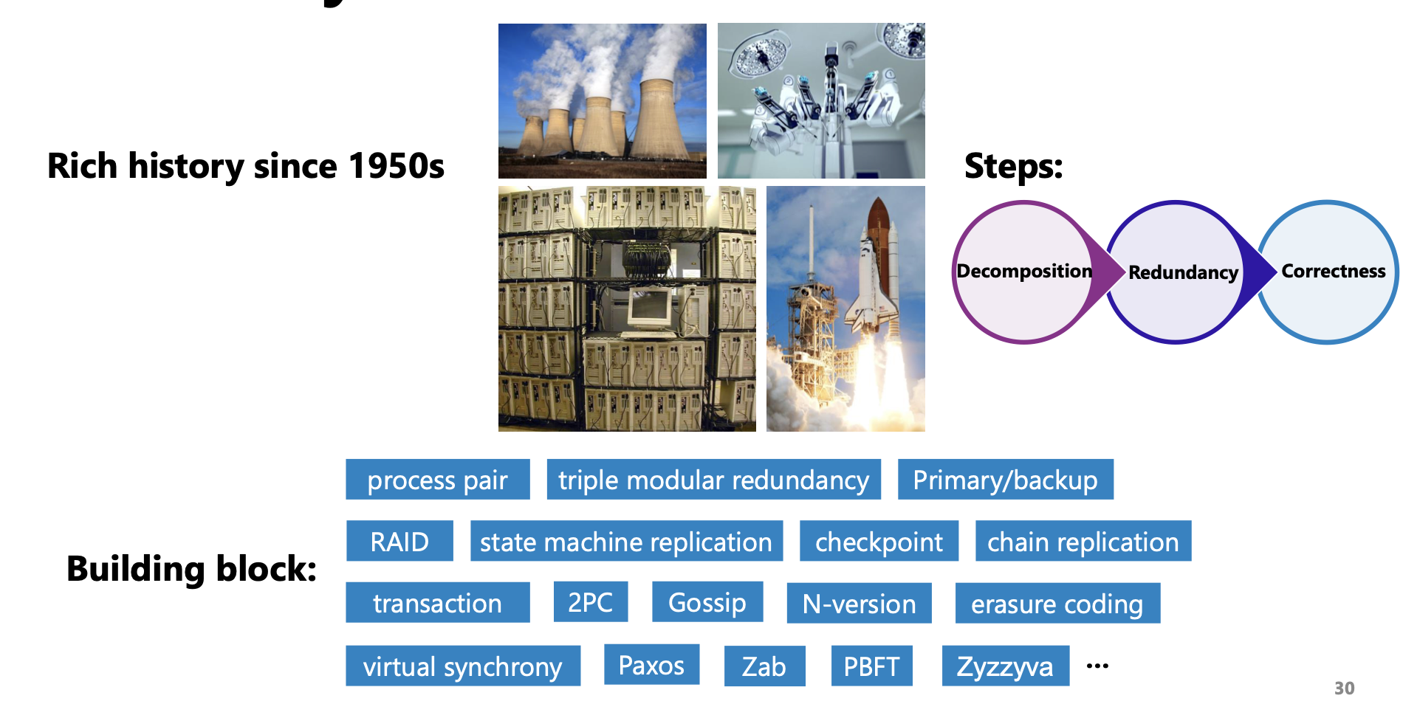
Fault-tolerance methods have been well-studied

Slide 69
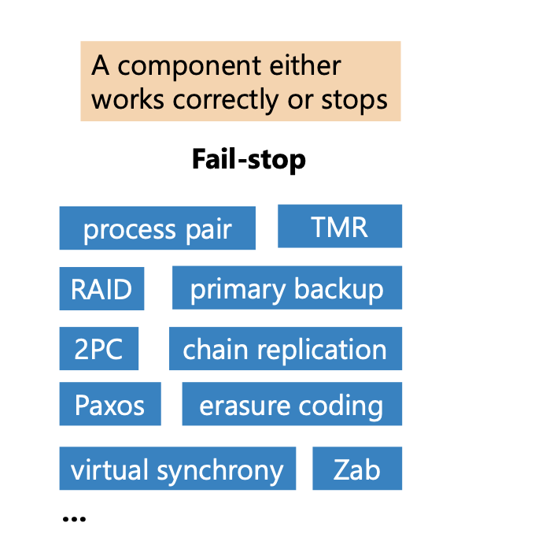
Gray failure
Traditional approaches consider a fail-stop manner

Slide 70
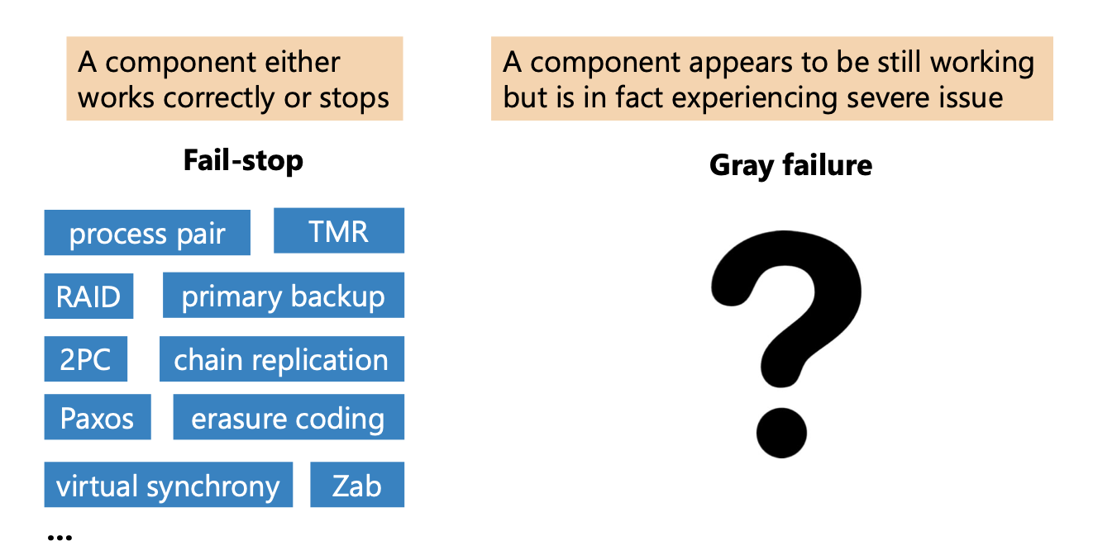
Gray failure

Slide 71
Gray failure
"Component failures whose manifestations are fairly subtle and thus defy quick and definitive detection"
Notes:
manifestation: 表现形式
defy: 难以

Slide 72
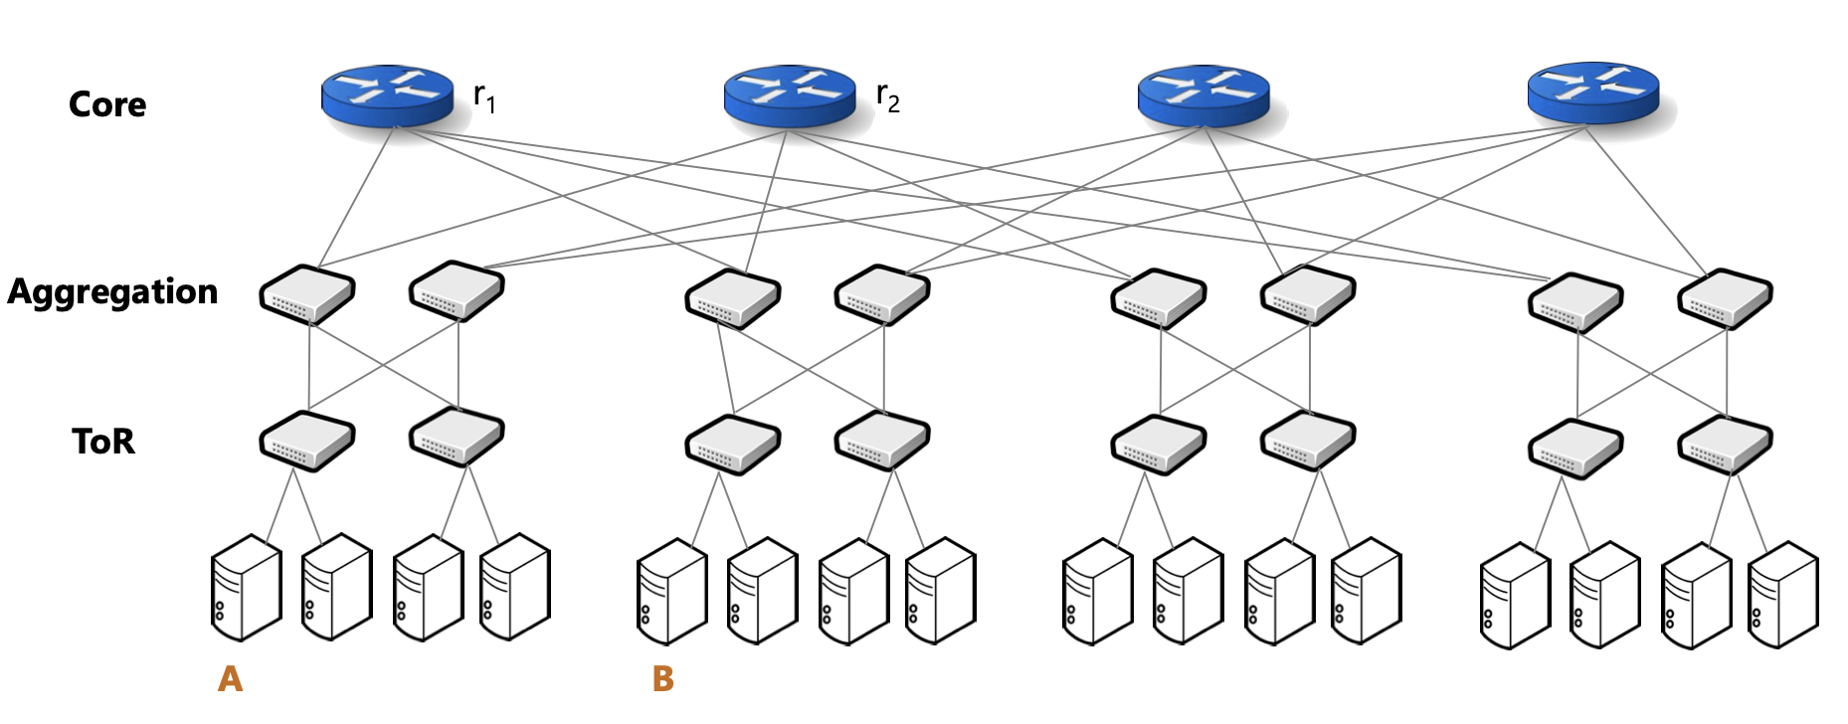
Case #1. Redundancy in Datacenter Network (1)
Notes:
为啥要fat-tree：即使一个交换机挂了，也没事

Slide 73
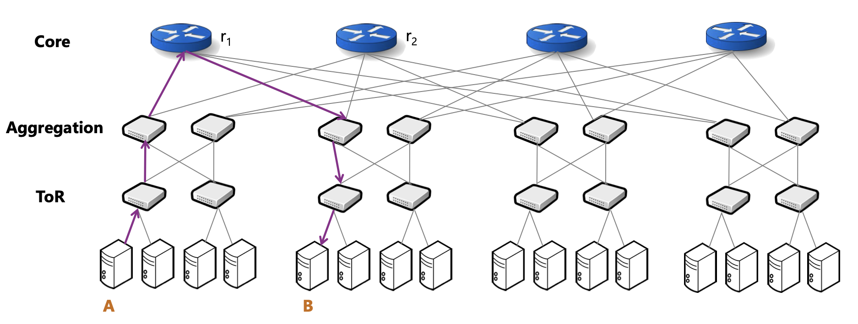
Case #1. Redundancy in Datacenter Network (1) s

Slide 74
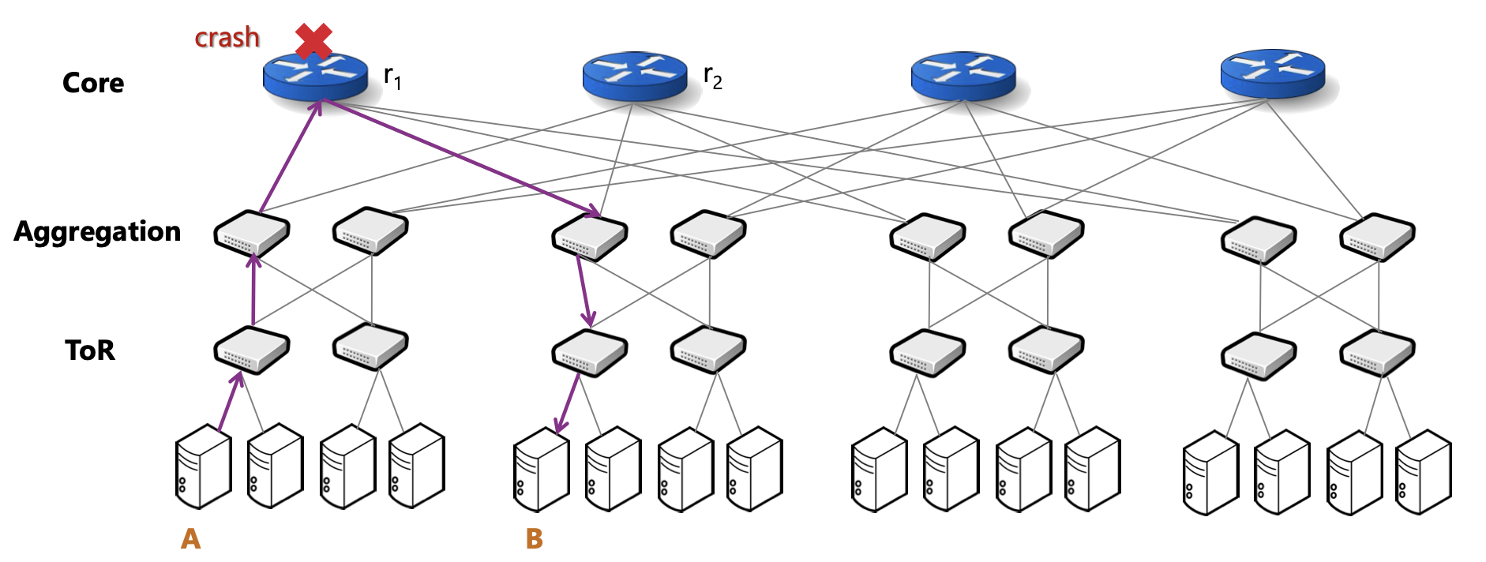
Case #1. Redundancy in Datacenter Network (1) s

Slide 75
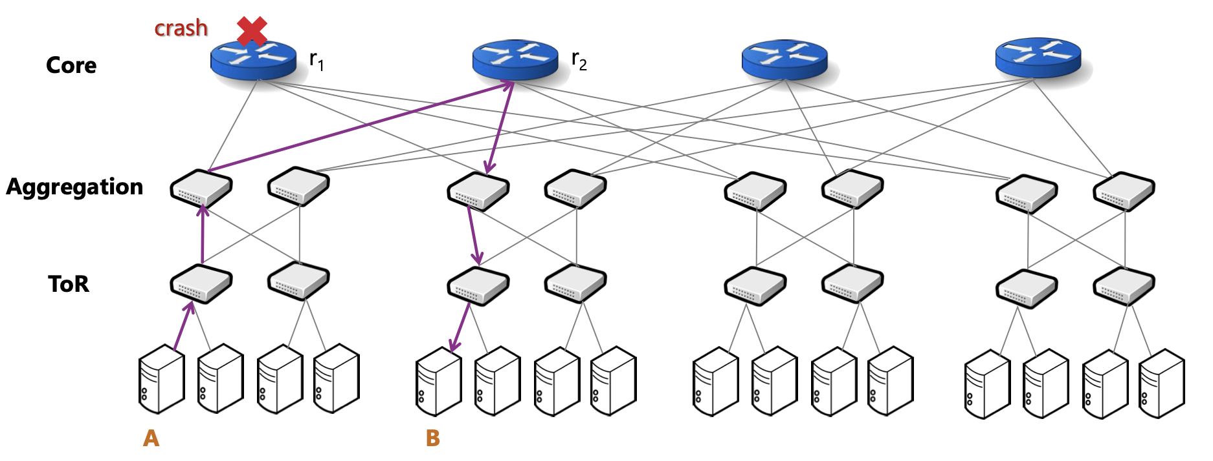
Case #1. Redundancy in Datacenter Network (1) s

Slide 76
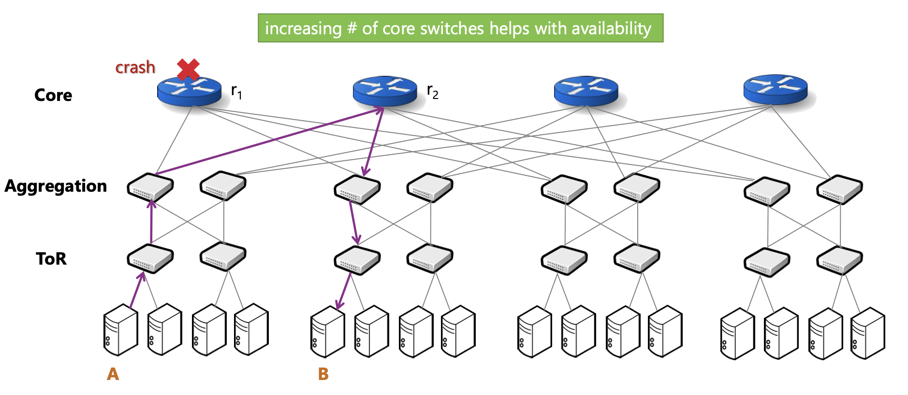
Case #1. Redundancy in Datacenter Network (1) s
Notes:
switch peer会根据附近switch的信息，判断neighbour是否挂了，这样即可以重试

Slide 77
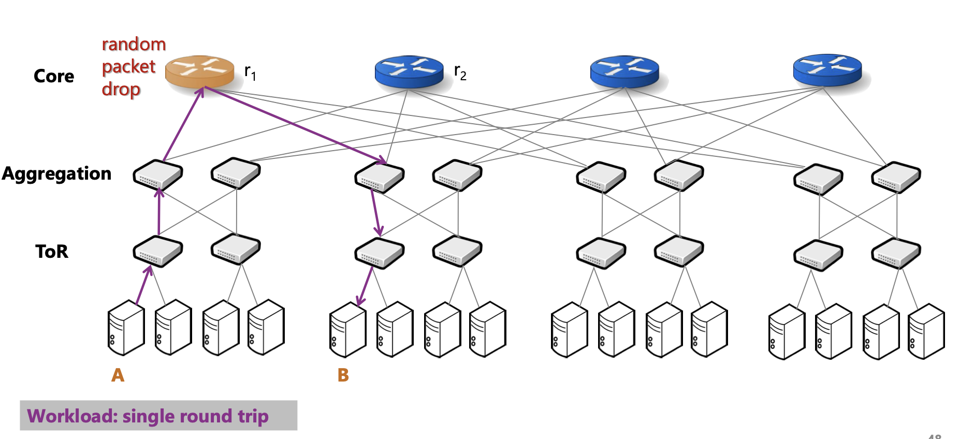
Case #1. Redundancy in Datacenter Network (2) s

Slide 78
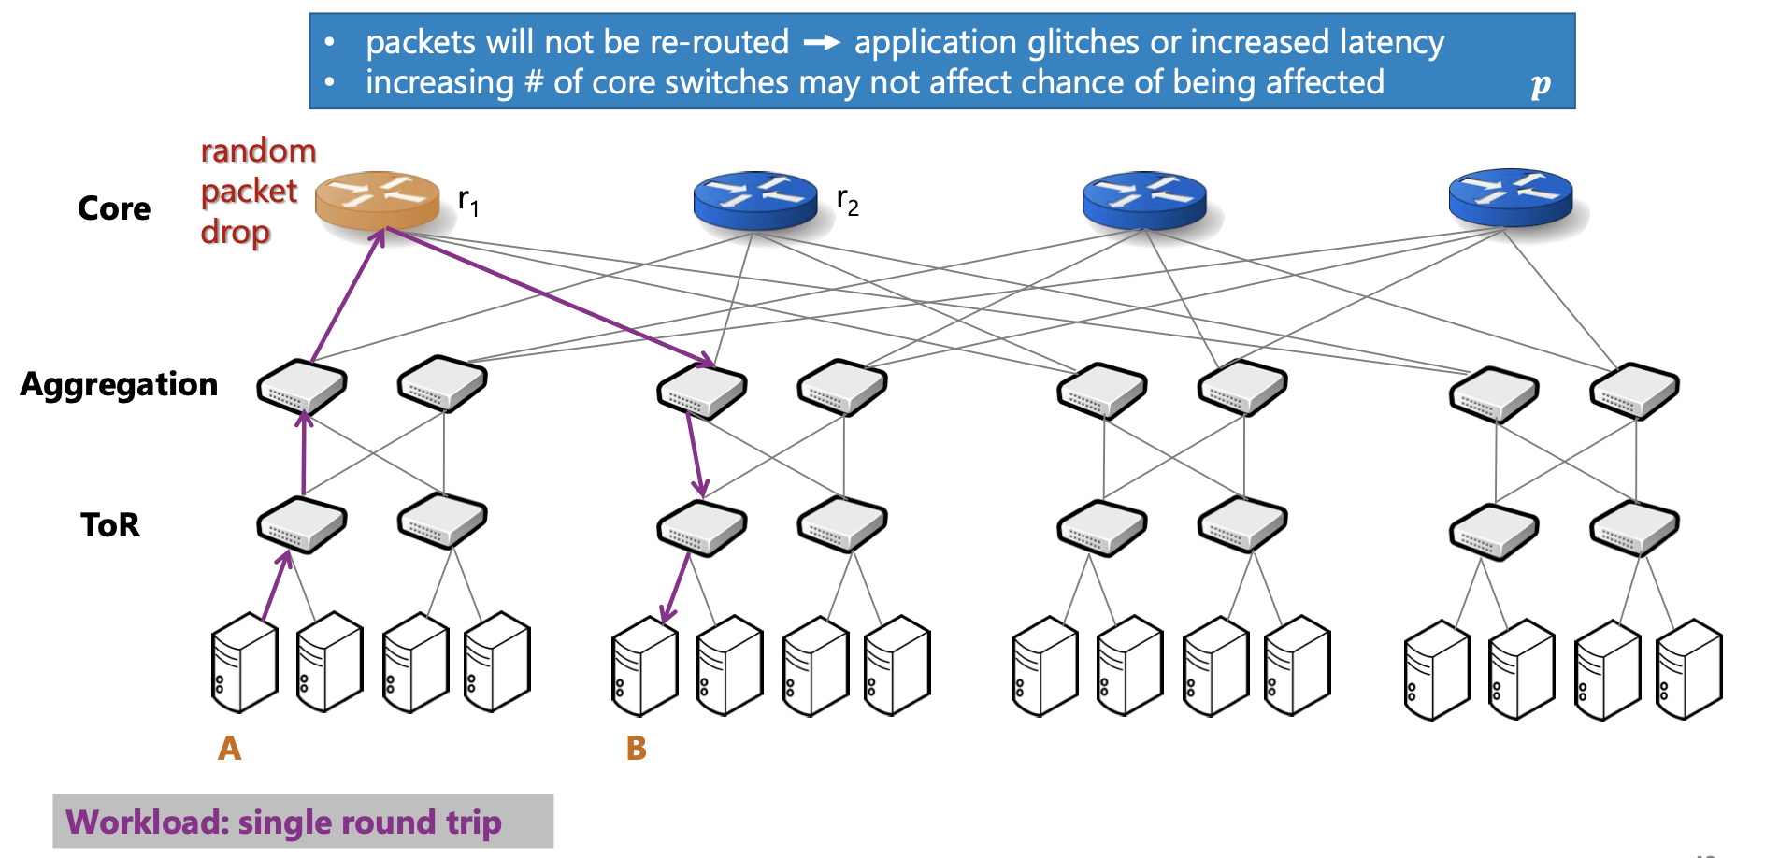
Case #1. Redundancy in Datacenter Network (2) s

Slide 79
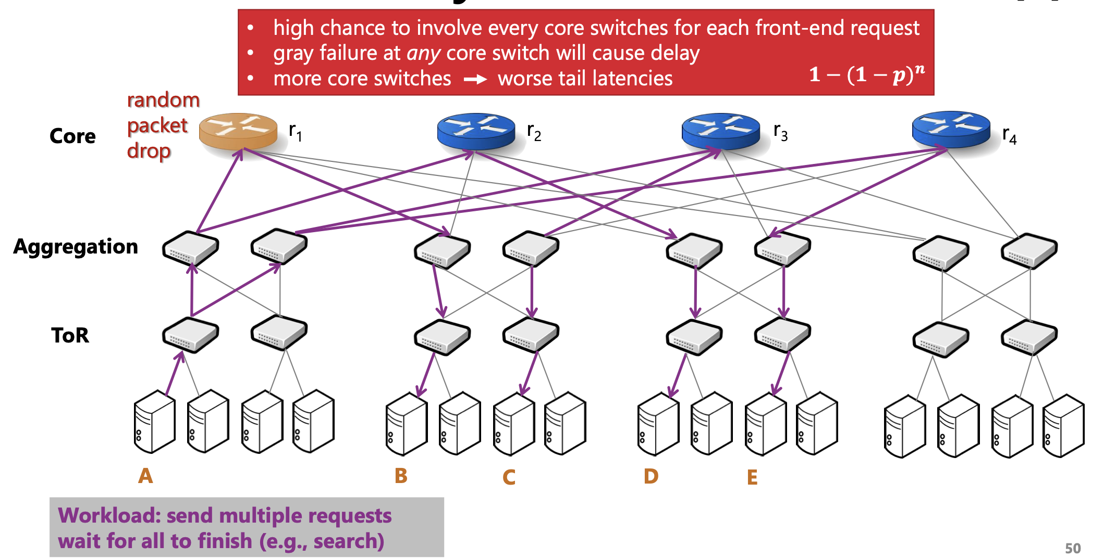
Case #1. Redundancy in Datacenter Network (3) s
Notes:
容错的switch越多，性能越容易受到影响

Slide 80
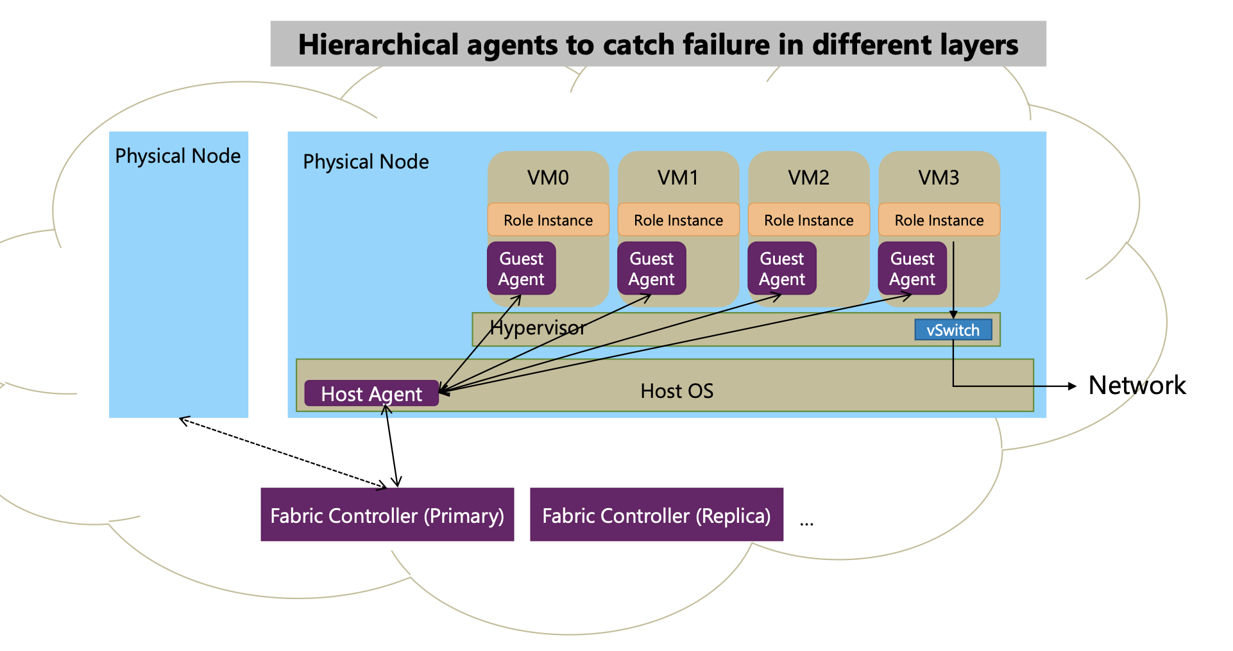
Case #2. Failure detector
Notes:
1. failure detector是啥
2. 讲下failure detector怎么做
3. 讲为啥用一个host agent来管理？（而不是单独ping VM） 减少ping的开销

Slide 81
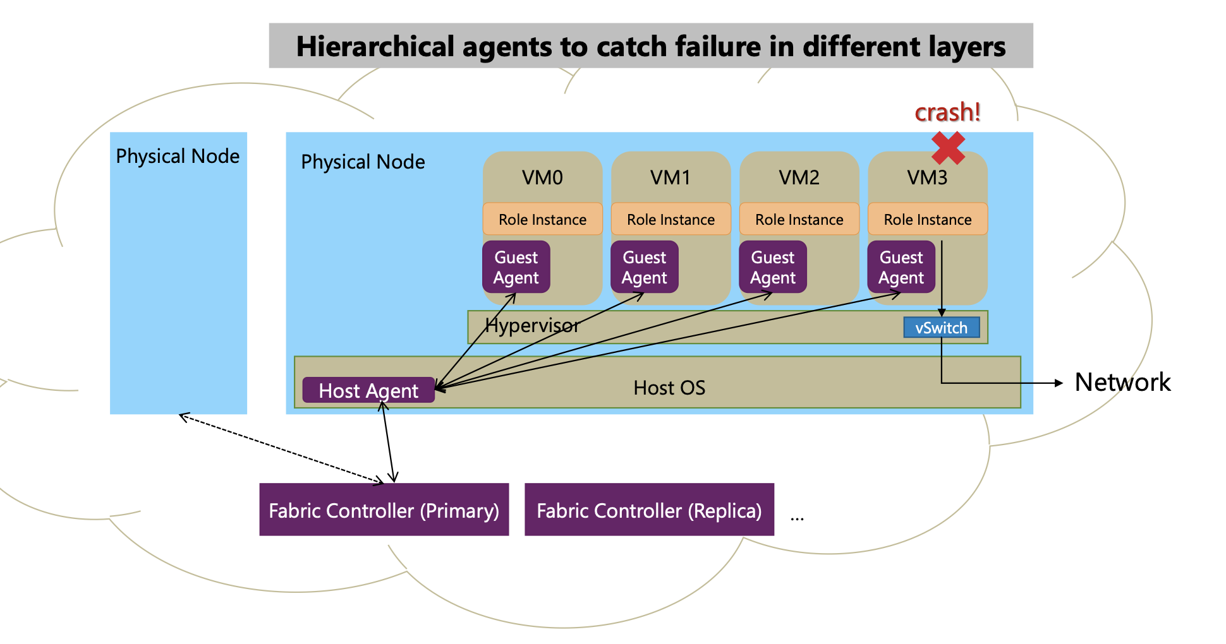
Case #2. Failure detector

Slide 82
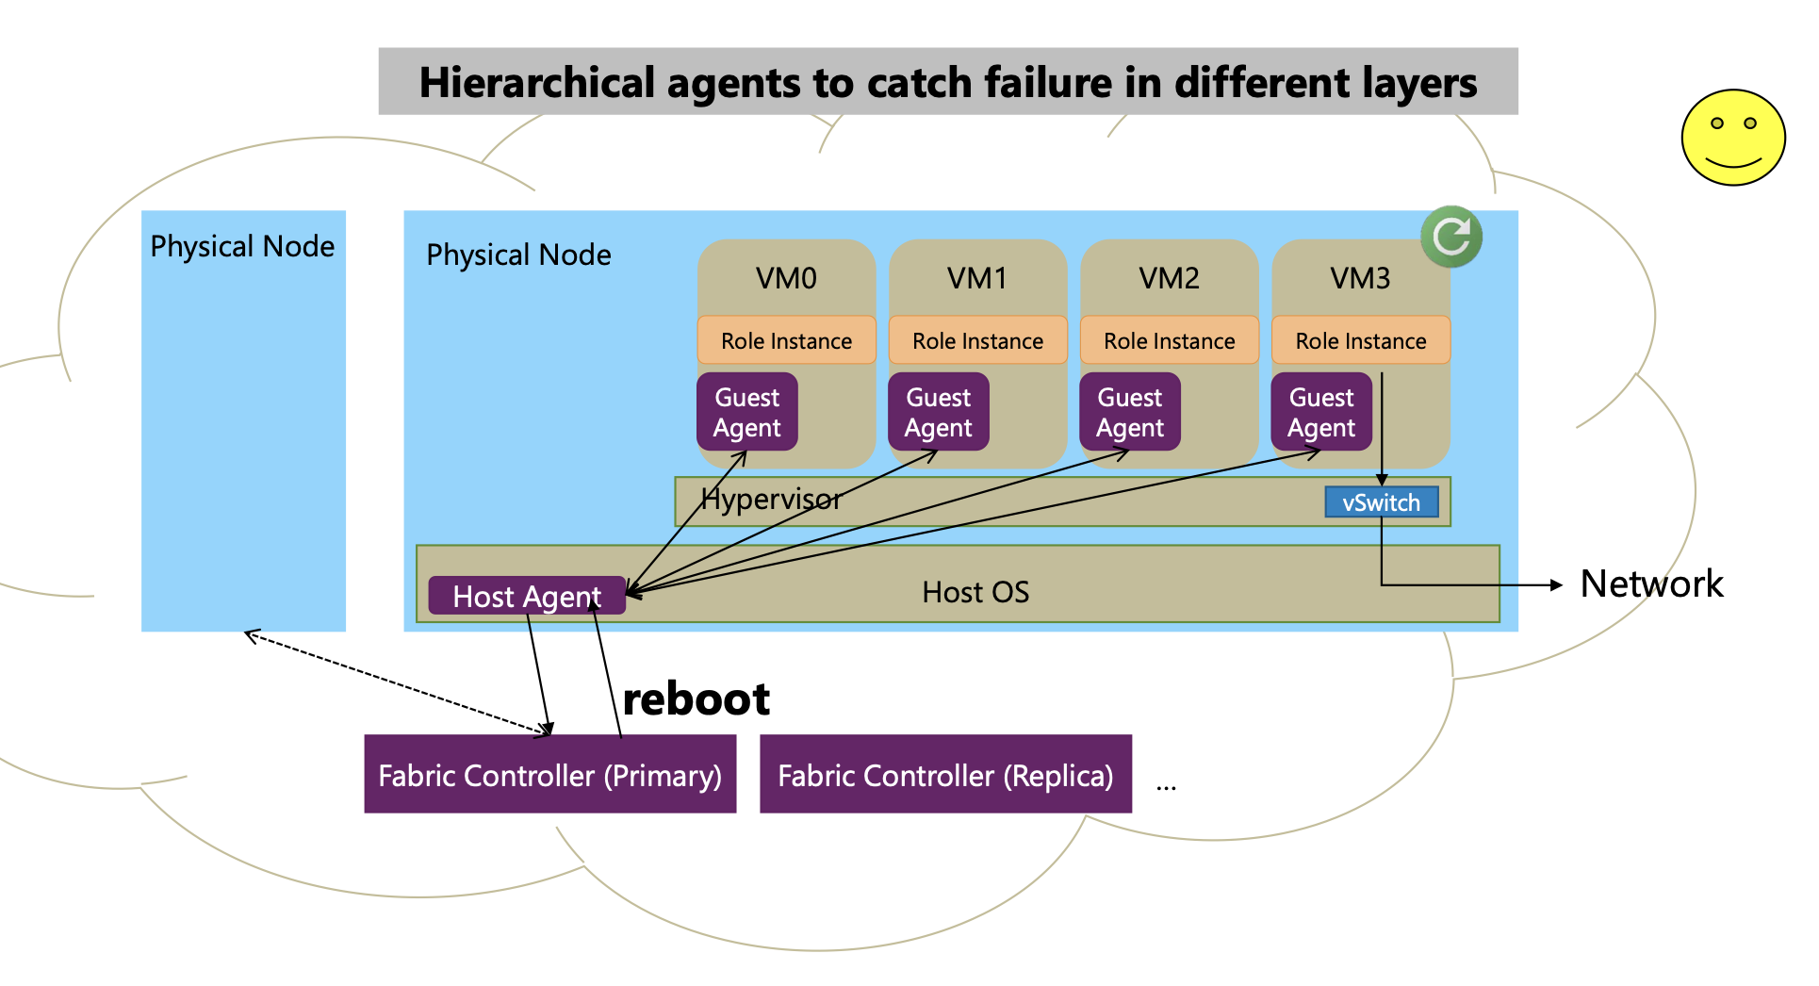
Case #2. Failure detector

Slide 83
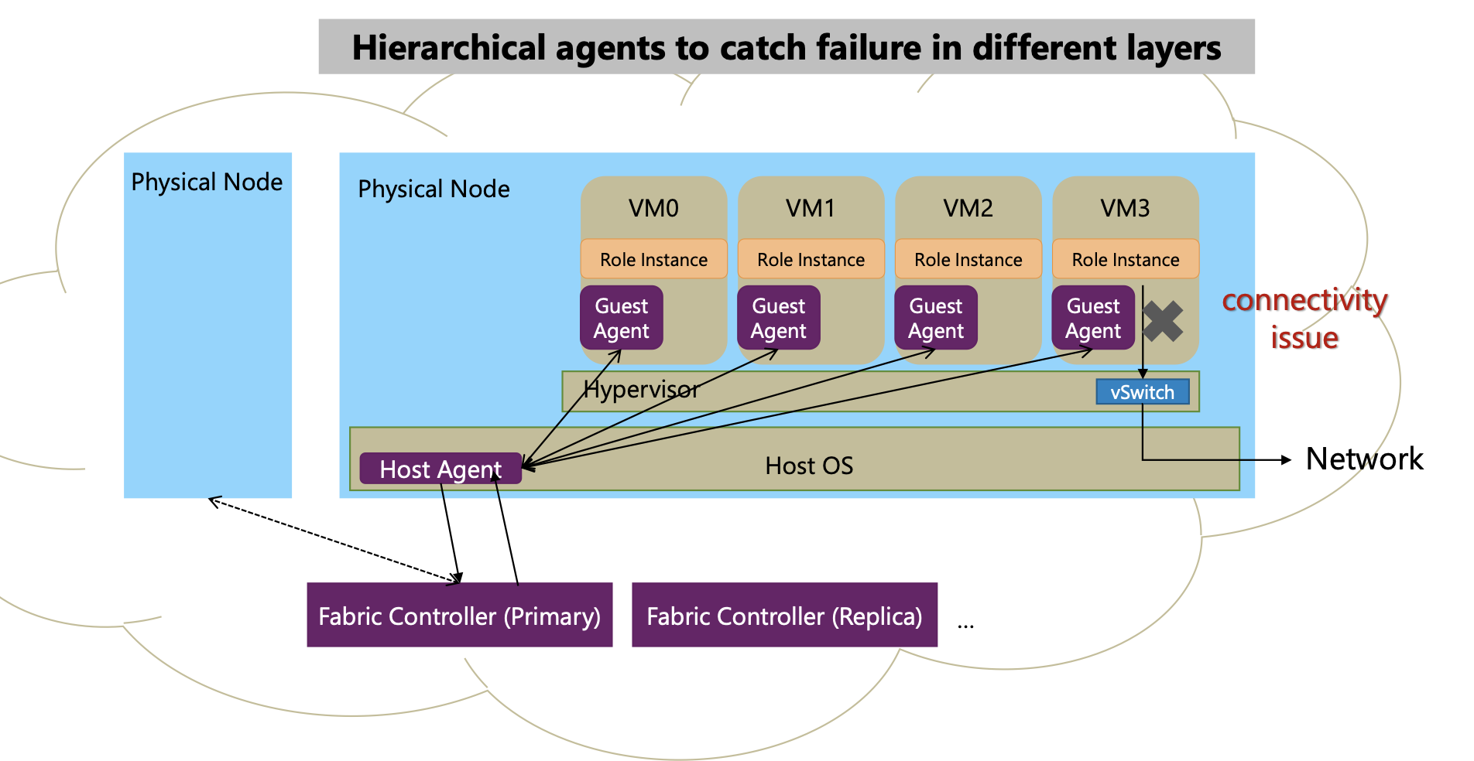
Case #2. Failure detector

Slide 84
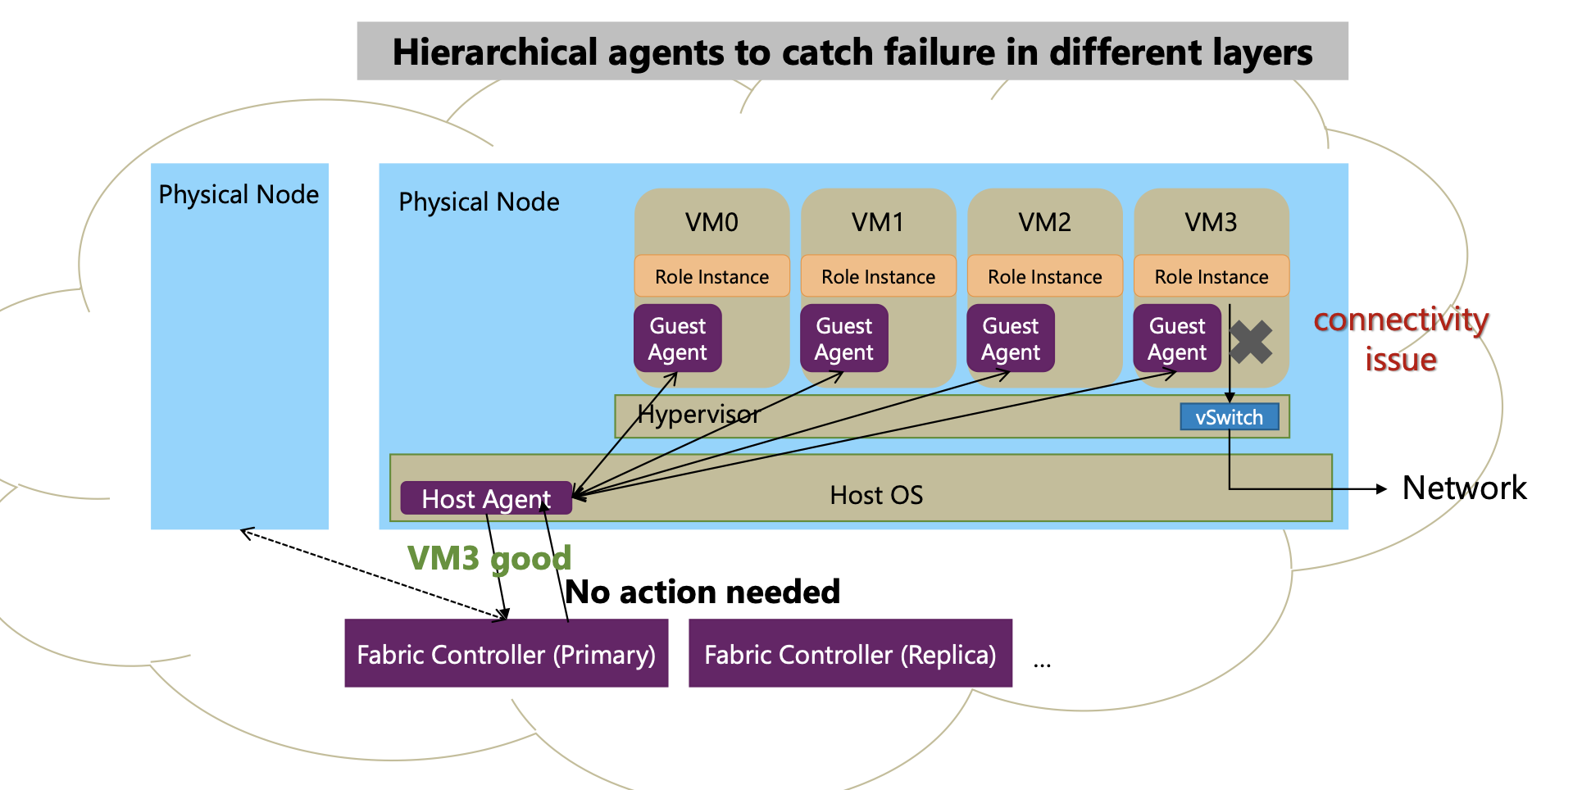
Case #2. Failure detector

Slide 85
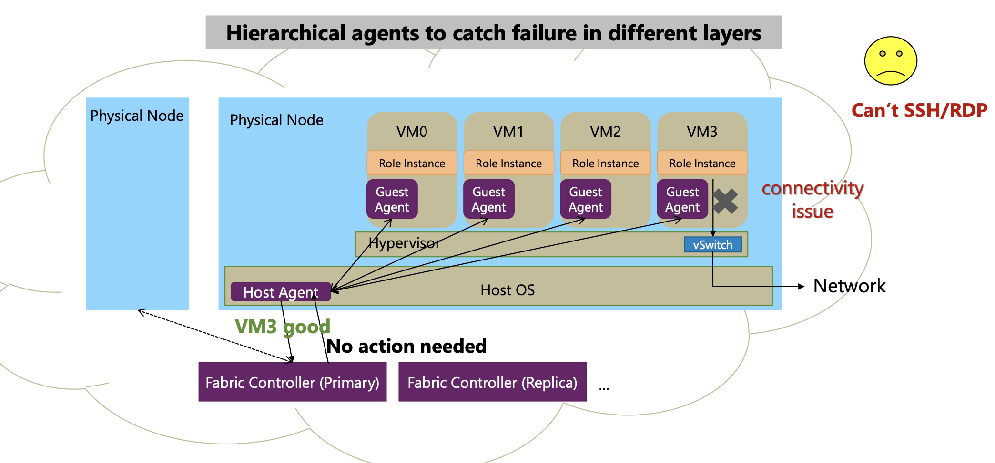
Case #2. Failure detector

Slide 86
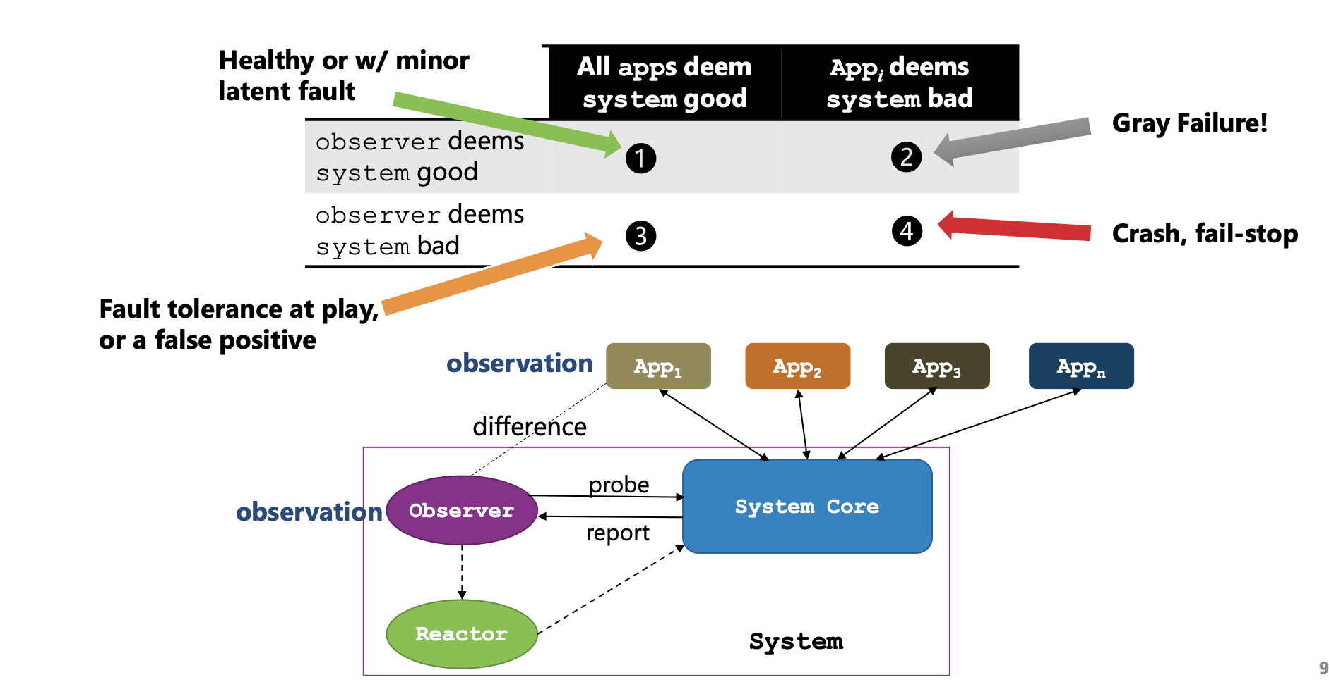
Gray failure trait: Differential Observability

Slide 87
Gray failure trait: Differential Observability
Notes:
想一下，哪些情况会有问题，哪些没有？

Slide 88
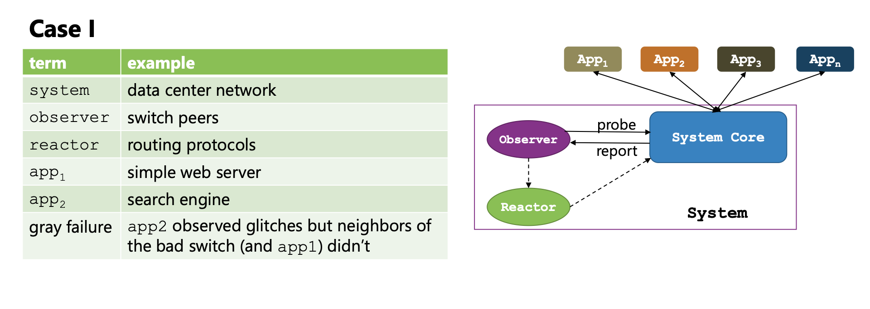
Applying the model

Slide 89
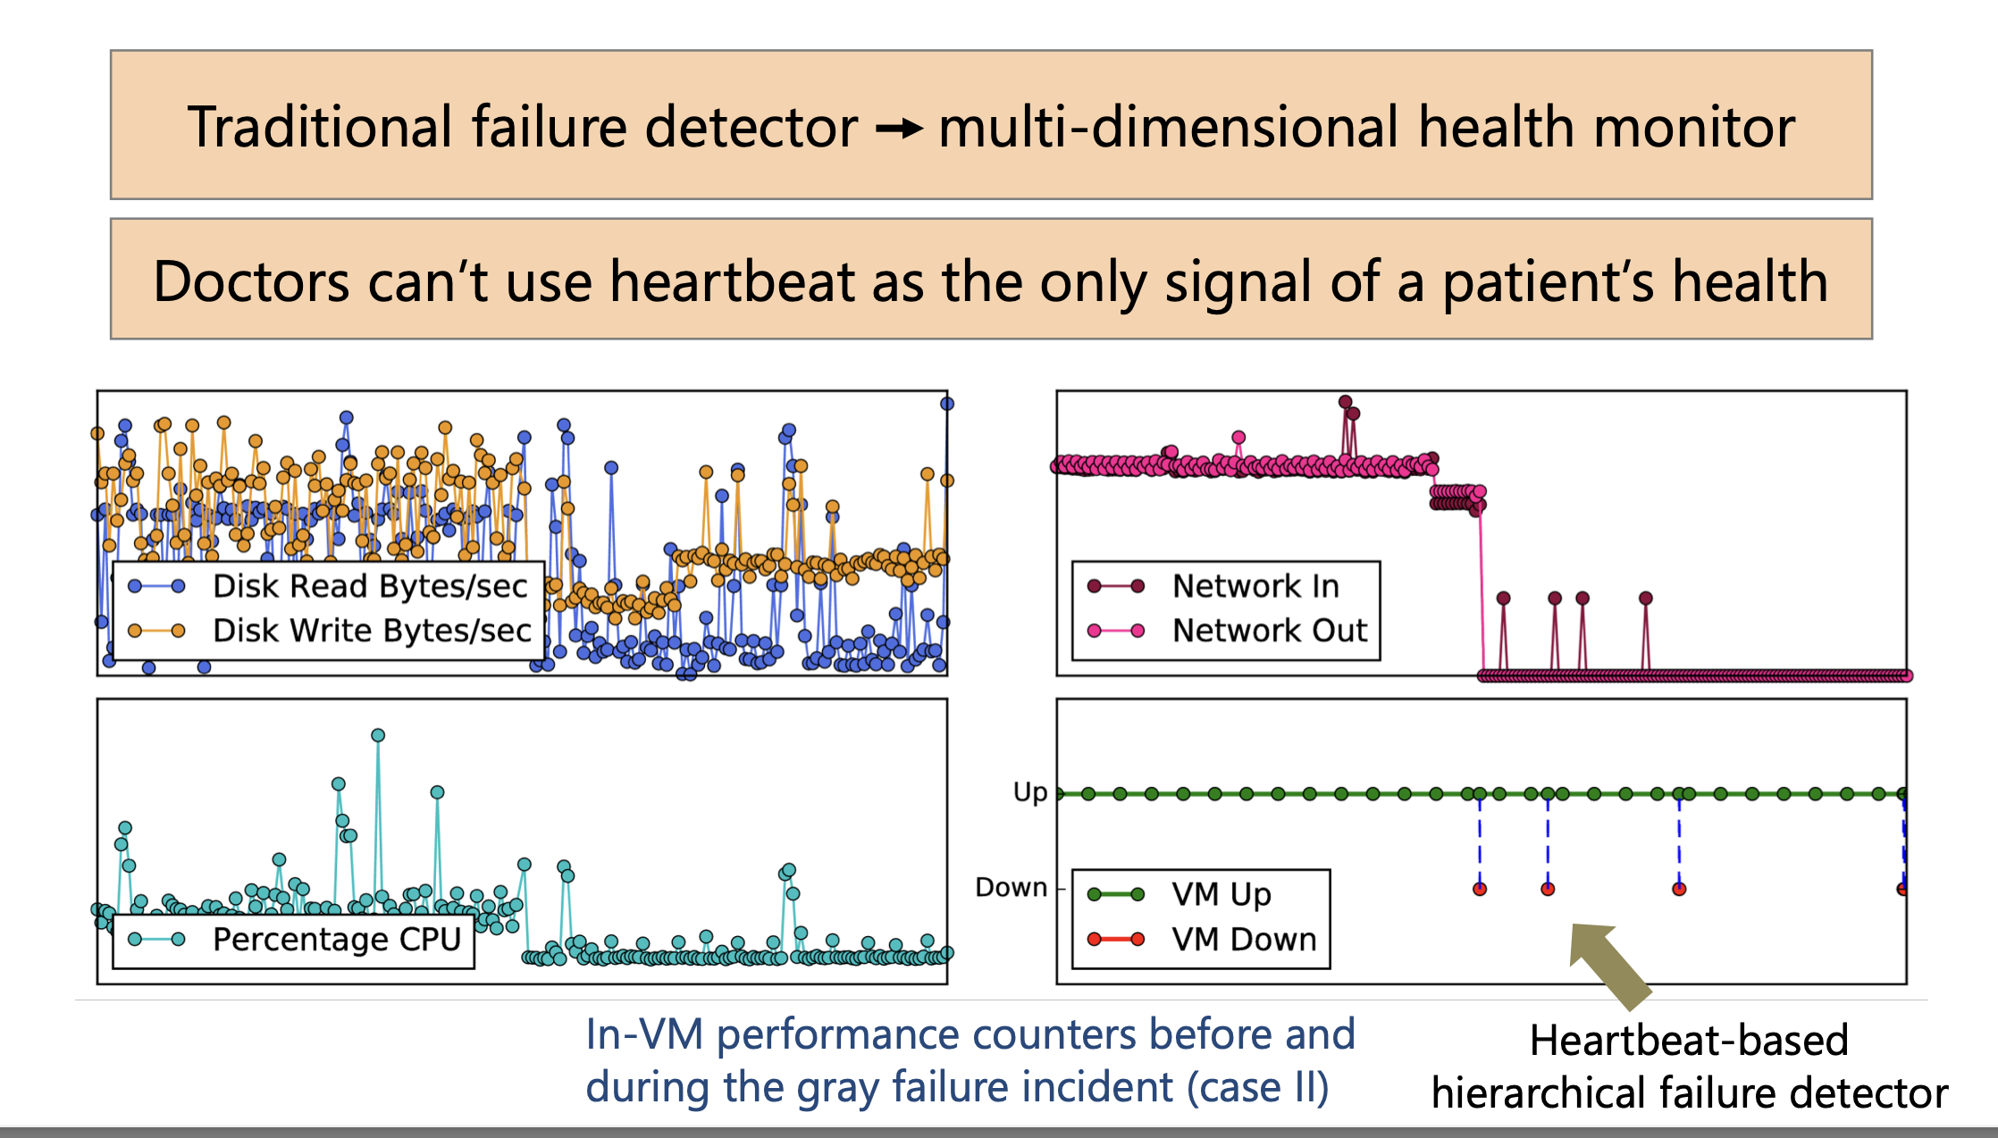
Direction #1. Close observation gap
Notes:
This is analogous to making assessments of a human body’s condition: we need to monitor not only his heartbeat, but also other vital signs including temperature and blood pressure.
图：各种monitor的实时观测结果
右下角： ovserver （没有发现问题）。红色的点：user正常的reboot

Slide 90

Direction #2. Approximating application views
Ideal: let system measure what its application observes
Infeasible to completely eliminate differential observability
due to multi-tenancy and modularity constraints
System sends probes to emulate common application usage
Notes:
核心：让observer观测application所能观测到的一切
实际：不practical； 而且在云场景中，用户不愿意把自己的观测结果交给平台
可能的solution：采用更多metric来观测用户的请求；比如，pingmesh会发送请求来预估用户请求的延迟

Slide 91
Direction #3. Leverage Power of Scale
Leveraging the observations from a large number of different components
To complement each other
Challenge: where to place the observation
Observable vs. detectable
Even we find the fault, it may not detect who is responsible
Example solution: infer signals from many network devices
Notes:
Example: 假设有个网络丢包了，到底是哪一步骤出问题了呢？

Slide 92
Properties every distributed system should consider
We have just briefly talked about consistency & fault tolerance
Notes:
先小结一下：我们讲了啥：1）需要scale，并且要scale到一个非常大的distributed system才能支持大website
2）其中遇到的挑战

Slide 93
Scalability & performance
Performance
How fast can we finish a computing job?
Depends on many factors
Algorithms complexity
System implementation
Hardware
Scalability
With more computing resources, can we enjoy a better performance?
With more computing resources, can we support a larger dataset?

Slide 94


Why can scalability typically improve performance?
Concurrency: apps run on multiple sources (e.g., CPU) concurrently
Scale-up: run computations using multiple threads concurrently
Scale-out: run computations using multiple machines concurrently
However, taming concurrency is hard
Scale up
Scale out
Notes:
既然说race condition是在 并发情况下才会发生，那我们得先说下何为并发。
并发就是指xxxx
其中有两种：xxxx。
为什么需要并发呢？ 因为我们处在一个多核和多机的时代：
1） 摩尔定律的消失
2）算力需求的增大

Slide 95

Notes:
Source: powergraph

Slide 96


Slide 97

Question: which system is better?

Slide 98
Question: which system is better?

Slide 99

Workload: graph processing

Slide 100

Workload: graph processing

Slide 101
What can go wrong?
Scalability has the cost
E.g. network communication is much slower than local accesses
Synchronizations overhead to ensure correctness
Fault tolerance mechanisms
Components in a distributed system can easily fail!

Slide 102

Notes:
Paul barham: tensorflow, pathway

Slide 103

ACID properties
A：Atomicity
C：Consistency
I：Isolation
D：Durability

Slide 104
Atomicity: all-or-nothing atomicity
An action is atomic if happens completely or not at all
Atomicity makes it much easier to reason about failures
Need to think about the consequences of the action happening or not happening, but not about the action partially happening
An action can be a group of other atomic actions
Under certain scenarios, a group of action is not atomic even all its sub-op is atomic! E.g., write the disk page containing record A

Slide 105
Atomicity can break even under a single machine
e.g., when copying a directory to another place
What happen if the computer crashes before the operation complete?
Many techniques exist
Write ahead logging
Replication
Etc.
We will talk about some in later lectures
Others can be found in other courses

Slide 106
ACID properties
A：Atomicity
C：Consistency
I：Isolation
D：Durability

Slide 107
Isolation: before-or-after atomicity
Before or after atomicity
Concurrent actions have the before-or-after property if their effect from the point of view of their invokers is as if the actions occurred either completely before or completely after one another

Slide 108


Example: bank account deposit
…
Single-thread (core)
Expected performance: D
Multiple-core (scale up)
Expected performance: D * C
Multiple-machine (scale out)
Expected performance: D * C * M
Bank = [
Alice: 0¥
Bob: 0¥
Deposit(bank, acct, amt):
bank[acct] += amt
Single-thread
Multiple-core
Multiple-machine
Deposit(bank,"alice”,10)
Time
…

Slide 109
Problem
Example: consider two threads access the same account concurrently
T0
T1
Deposit(bank,"alice”,10)
Deposit(bank, acct, amt):
bank[acct] += amt
Time
Question: what would happen?

Slide 110
Problem: missing updates
Example: consider two threads access the same account concurrently
T0
T1
Deposit(bank,"alice”,10)
Deposit(bank, acct, amt):
bank[acct] += amt
Time
Question: what would happen?
Alice: 0¥
Alice: 10¥ (20¥)

Slide 111
Core problem: atomicity of the + operator
Example: consider two threads access the same account concurrently
Why would this happen?
The deposit function is not atomic
mov acct, %eax
add $amt, %eax
mov %eax, acct
Deposit(bank, acct, amt):
bank[acct] += amt
Developer’s written code
Compiler’s generated code

Slide 112
Core problem: atomicity of the + operator
mov acct, %eax
add $amt, %eax
mov %eax, acct
Deposit(bank, acct, amt):
bank[acct] += amt
Developer’s written code
Compiler’s generated code
Thread 0
Thread 1
Bank[Alice]
0
T0
T1
Deposit(bank,"alice”,10)
Time

Slide 113
Core problem: atomicity of the + operator
mov acct, %eax
add $amt, %eax
mov %eax, acct
Deposit(bank, acct, amt):
bank[acct] += amt
Developer’s written code
Compiler’s generated code
Thread 0
Thread 1
Bank[Alice]
0
Read acct
0
T0
T1
Deposit(bank,"alice”,10)
Time

Slide 114
Core problem: atomicity of the + operator
mov acct, %eax
add $amt, %eax
mov %eax, acct
Deposit(bank, acct, amt):
bank[acct] += amt
Developer’s written code
Compiler’s generated code
Thread 0
Thread 1
Bank[Alice]
0
Read acct
0
T0
T1
Read acct
0
Deposit(bank,"alice”,10)
Time

Slide 115
Core problem: atomicity of the + operator
mov acct, %eax
add $amt, %eax
mov %eax, acct
Deposit(bank, acct, amt):
bank[acct] += amt
Developer’s written code
Compiler’s generated code
Thread 0
Thread 1
Bank[Alice]
0
Read acct
0
T0
T1
Read acct
0
Deposit(bank,"alice”,10)
0
Increase
Time

Slide 116
Core problem: atomicity of the + operator
mov acct, %eax
add $amt, %eax
mov %eax, acct
Deposit(bank, acct, amt):
bank[acct] += amt
Developer’s written code
Compiler’s generated code
Thread 0
Thread 1
Bank[Alice]
0
Read acct
0
T0
T1
Read acct
0
Deposit(bank,"alice”,10)
0
Increase
Increase
0
Time

Slide 117
Core problem: atomicity of the + operator
mov acct, %eax
add $amt, %eax
mov %eax, acct
Deposit(bank, acct, amt):
bank[acct] += amt
Developer’s written code
Compiler’s generated code
Thread 0
Thread 1
Bank[Alice]
0
Read acct
0
T0
T1
Read acct
0
Deposit(bank,"alice”,10)
0
Increase
Increase
0
Write acct
10
Time

Slide 118
Core problem: atomicity of the + operator
mov acct, %eax
add $amt, %eax
mov %eax, acct
Deposit(bank, acct, amt):
bank[acct] += amt
Developer’s written code
Compiler’s generated code
Thread 0
Thread 1
Bank[Alice]
0
Read acct
0
T0
T1
Read acct
0
Deposit(bank,"alice”,10)
0
Increase
Increase
0
Write acct
10
Time
Write acct
10

Slide 119
We will talk about how to ensure isolation in the late lectures

Slide 120
Consistency & Durability
Consistency
Informally, the data is consistent
Many consistency level exists
Question: does A + I ensures consistency?
We will see more examples later
Durability
Informally, finished operations are persisted on the durable storage
Simple to achieve, techniques to achieve A typically achieves D

Slide 121
Ease of programming
How easy can we build new applications?

Slide 122

How do we program in a single (multi-core) machine?
We cannot program over the bare-metal machine ☺
CPU
Cache + DRAM
CPU0
CPU1
Cache
Cache
DRAM

Slide 123
How do we program in a single (multi-core) machine?
OS & hardware provides a simple programming model
Threads + shared memory
CPU => Threads
Cache + DRAM => Shared (virtual) memory
Thread 0
Thread 1
CPU0
CPU1
Cache
Cache
Shared
virtual
memory
DRAM

Slide 124

What about a scale (distributed) system?
OS & hardware provides a simple programming model for laptop
Threads + shared memory
What is the hardware of a distributed systems??
Multiple machines connected via the network!
CPU0
Machine 0
DRAM0
CPU1
Machine 1
DRAM1
Notes:
为了简化，假设服务器没有cache

Slide 125
Distributed shared memory
OS & hardware provides a simple programming model
Threads + shared memory
Can we abstract the hardware into a giant machine?
Thread 0
Thread 1
CPU0
Machine 0
DRAM0
CPU1
DSM
DRAM0 + DRAM1
Machine 1
DRAM1
Notes:
为了简化，假设服务器没有cache

Slide 126

Threads + (distributed) shared memory
Think of running a multi-core program on a machine with
10PB+ of memory
10,000 + CPU cores (threads)
Benefit: Transparency!
Application can program the multi-core (machine) like a
single machine.

Slide 127
Challenge: efficiency!
CPU has hardware-built coherence protocols for shared memory
Nearly all programmers use to develop applications
Coherence protocols are challenging to scale to a distributed setting
Network latency
Failure
Etc.

Slide 128
Programming model for distributed system
In old days, people uses threads + message passing to build distributed systems
E.g., use pthreads to start a lot of threads on a lot of machines
Use RPC or MPI to exchange information between them

Slide 129
Pthread and MPI
Pthread
A common library to start multiple threads
Threads can communicate with shared memory
MPI
Frameworks for starting multiple processes across a set of nodes
Each process can be multi-threaded
Processes can send messages to each other with its APIs

Slide 130
Threads and Messages
Experts repeatedly solve the same parallel design challenges
Implement and debug complex parallel systems
Tune for a specific parallel platform

Slide 131
Threads and Messages
Graduate Student
Experts repeatedly solve the same parallel design challenges
Implement and debug complex parallel systems
Tune for a specific parallel platform
6 months later, a conference paper contains:
However, the resulting code will be difficult to maintain and extend
“We implemented ____ in parallel.”
couples learning model with parallel implementation

Slide 132
Customized programming models for distributed systems
Generalized MapReduce-like API (Batch processing systems)
MapReduce, Spark, etc.
Vertex-centric model (Graph processing systems)
GraphLab, PowerGraph, etc.
Dataflow & Matrix (machine learning systems)
Tensorflow, Pathway, etc.
SQL (distributed databases)
Spanner, TiDB, etc.

Slide 133
Summary of the (ideal) properties of distributed systems
Can our system handle a larger workload?
Scalability
How easy the developer
can use our system?
How fast is our system?
Ease of programming
Performance
Consistency
Fault tolerance
Is our data/computation
correct?
What if some component crash?

Slide 134
Summary of the (ideal) properties of distributed systems
Sharding
Replication
Load balancing
New hardware
Scalability
Ease of programming
Performance
DSM, RPC, MapReduce, …
Caching
Consistency
Fault tolerance
Sequential, eventual,
consensus, isolation, etc.
High availability: replication & checkpointing
Durability: atomicity, logging, etc.

Slide 135
Summary of the (ideal) properties of distributed systems
These properties typically cannot achieve at the same time
The adults want them all, but the reality forces them to make trade-offs
Remote Procedure Call (RPC)
Distributed Shared Memory (DSM)
Scalability
Scalability
Ease of
programming
Performance
Ease of
programming
Performance
Consistency
Fault tolerance
Consistency
Fault tolerance
NoSQL databases
NewSQL databases (e.g., Spanner)
Scalability
Scalability
Ease of
programming
Performance
Ease of
programming
Performance
Consistency
Fault tolerance
Consistency
Fault tolerance

